Slide 1
STUDIO KLOKOČKA – Institute of Urban Planning semester 1 / 2023-2024 Jiří Klokočka (B)

Slide 2
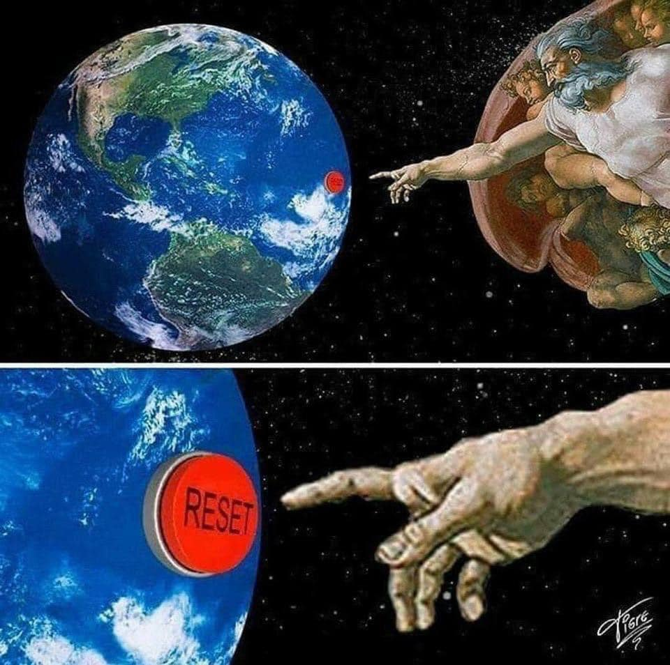

Slide 3
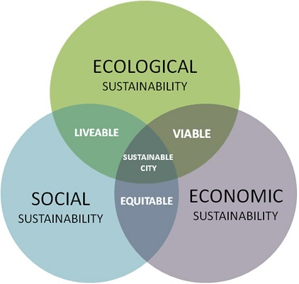

Slide 4
General sustainability
Climate warming
Energy self-sufficiency
Recyclable city
Layering of functions in buildings
Layering of functions in the city – the hybrid city
Stratification of industrial zones
Transport
Smart Cities
Open city (social dimension)
Fifteen-minute-city
European dimension

Slide 5
These topics will determine the overall approach to the semester project, in thinking about the future of the city, from analysis to design. We will be a kind of urban planning laboratory. This means we will think and design in alternatives.

Slide 6
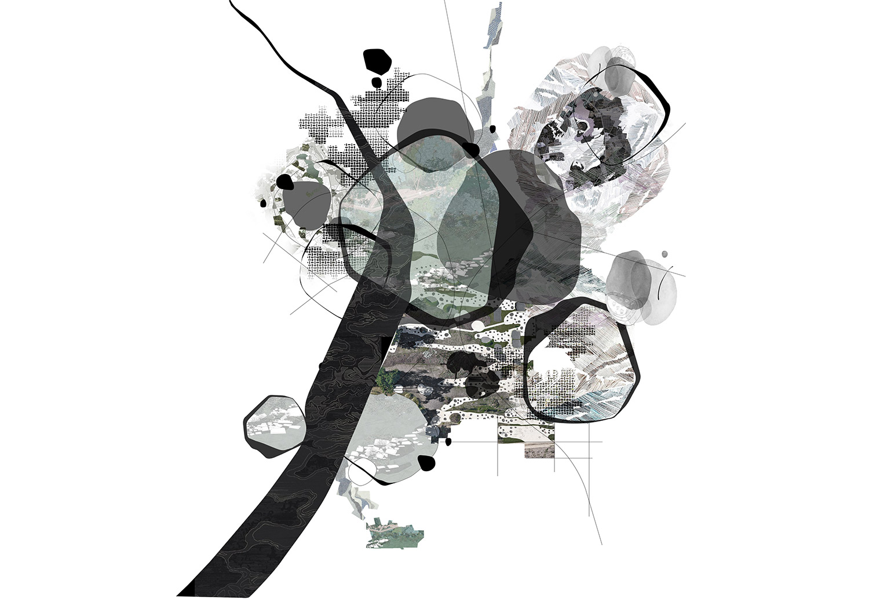
ASSIGNMENT 1 – STRUCTURAL PLAN TÁBOR

Slide 7
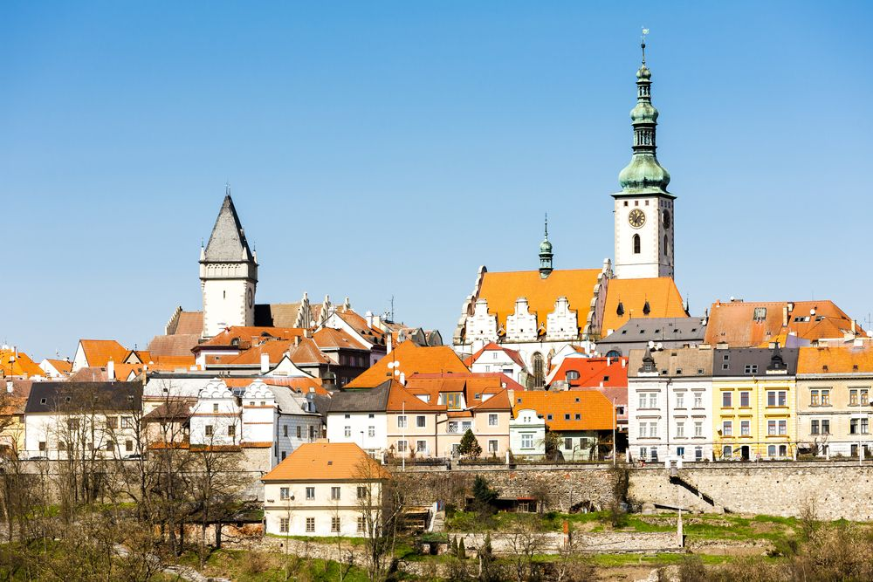
ASSIGNMENT 1 – STRUCTURAL PLAN TÁBOR

Slide 8
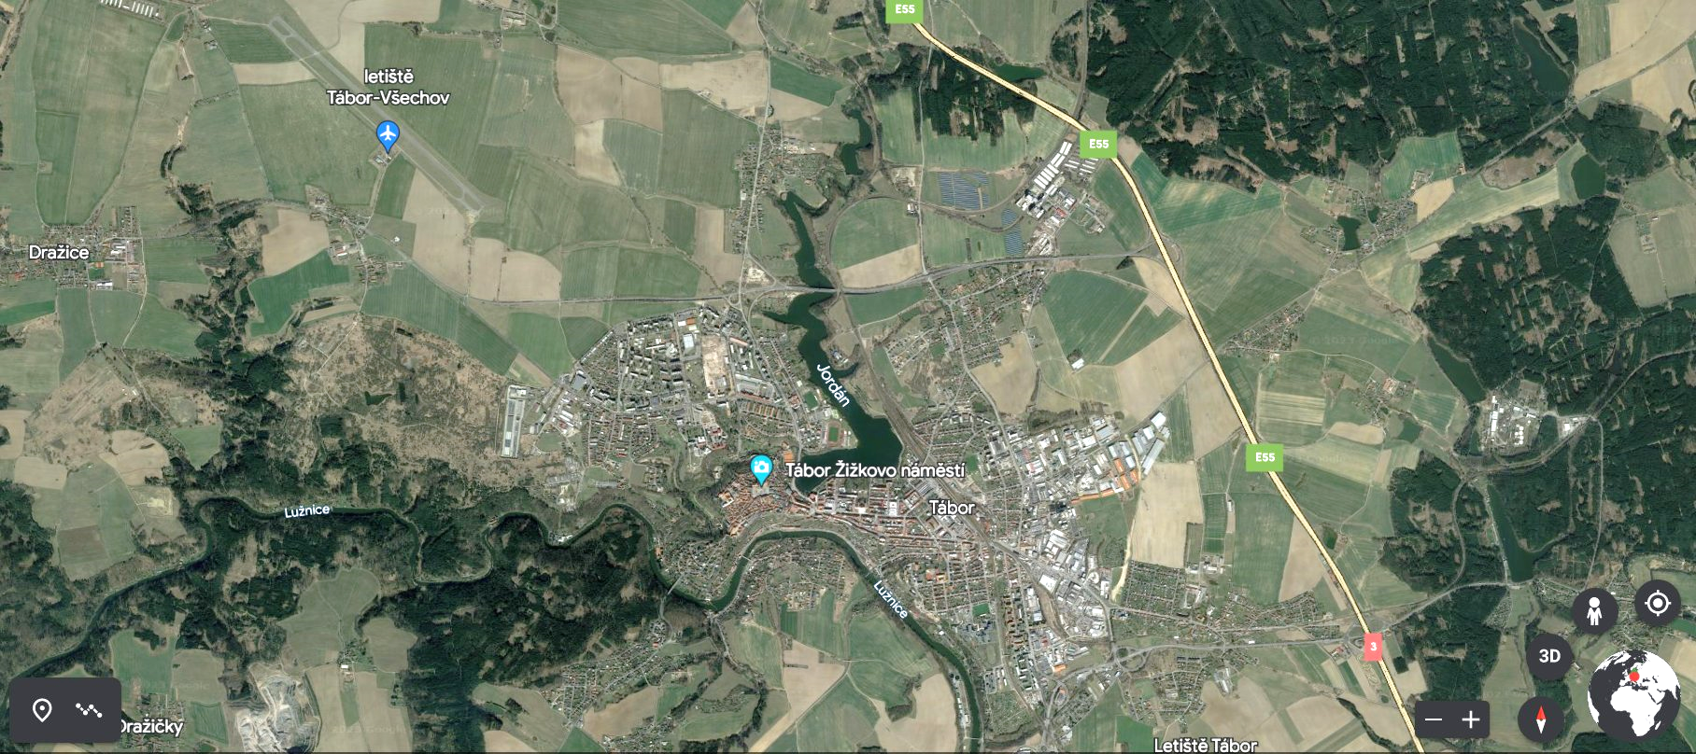
ASSIGNMENT 1 – STRUCTURAL PLAN TÁBOR

Slide 9
ASSIGNMENT 1 – STRUCTURAL PLAN TÁBOR
Settlement structure
Economic structure
Traffic structure
Agricultural structure
Blue-green structure
Landscape structure
Recreational structure

Slide 10
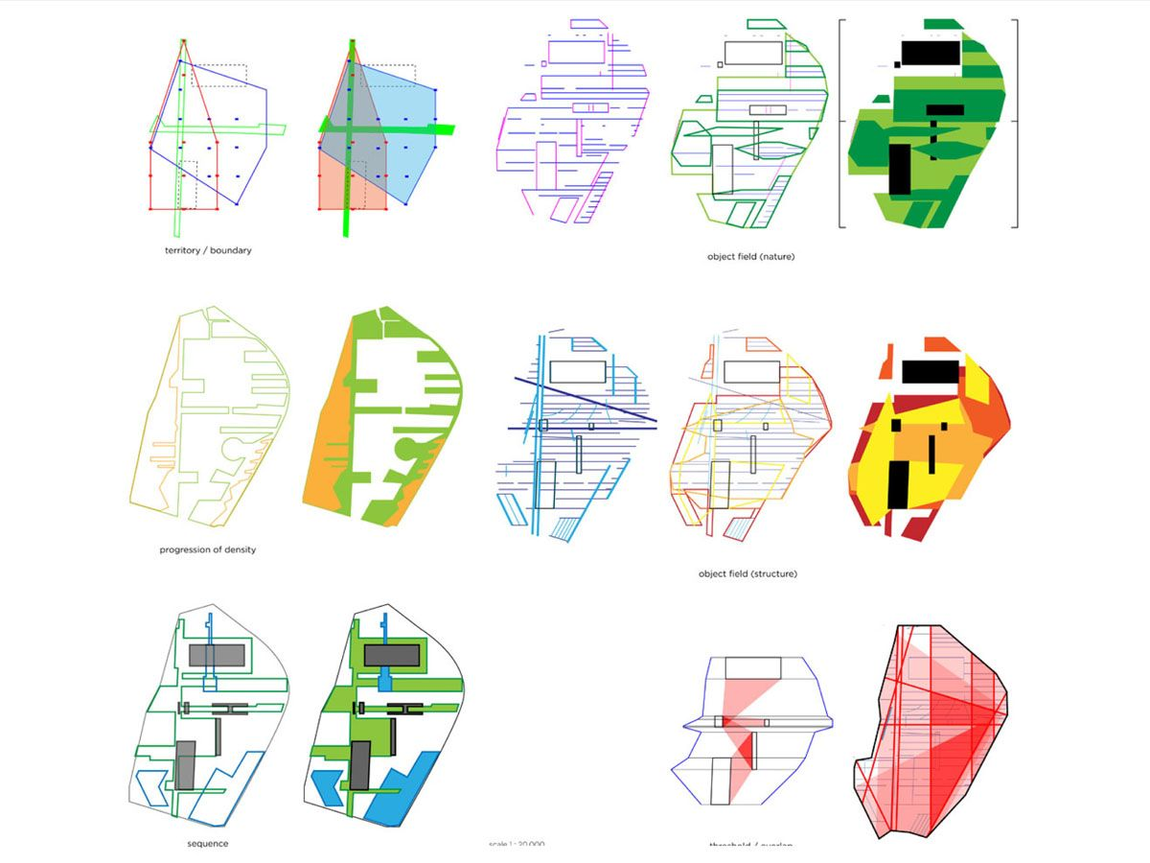
ASSIGNMENT 1 – STRUCTURAL PLAN TÁBOR

Slide 11
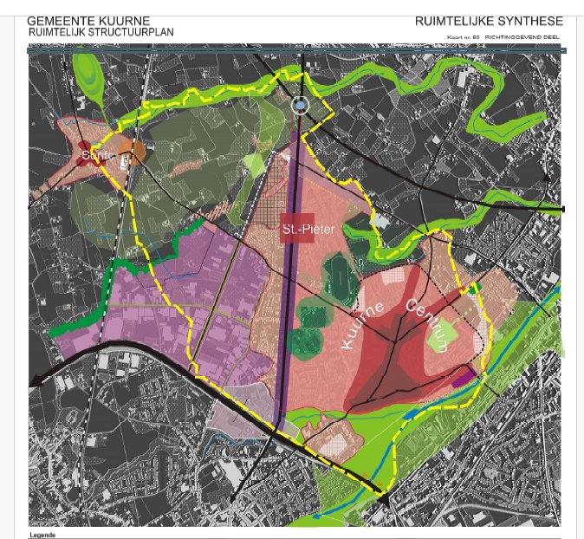

Slide 12
ZADÁNÍ 2 – PRAHA, SLATINY
Even in a big city like Prague, there are a number of places, enclaves, which, although they are close to the center, are isolated from the city, both physically and mentally, emotionally. They are often called the "inner periphery". These places hide a whole range of possibilities for future development (or "non-development"). We will deal with this topic at the Slatiny location in Prague 10.

Slide 13
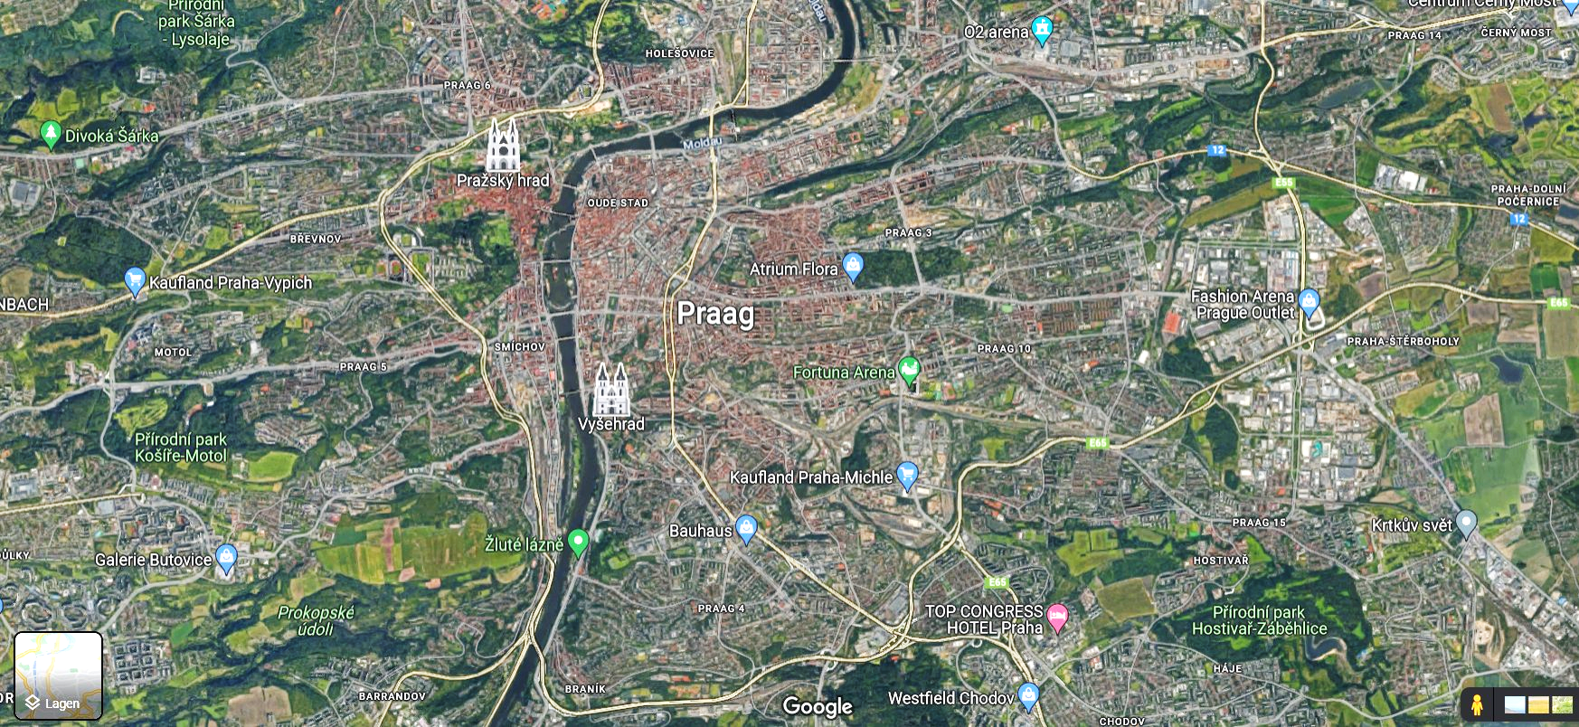

Slide 14
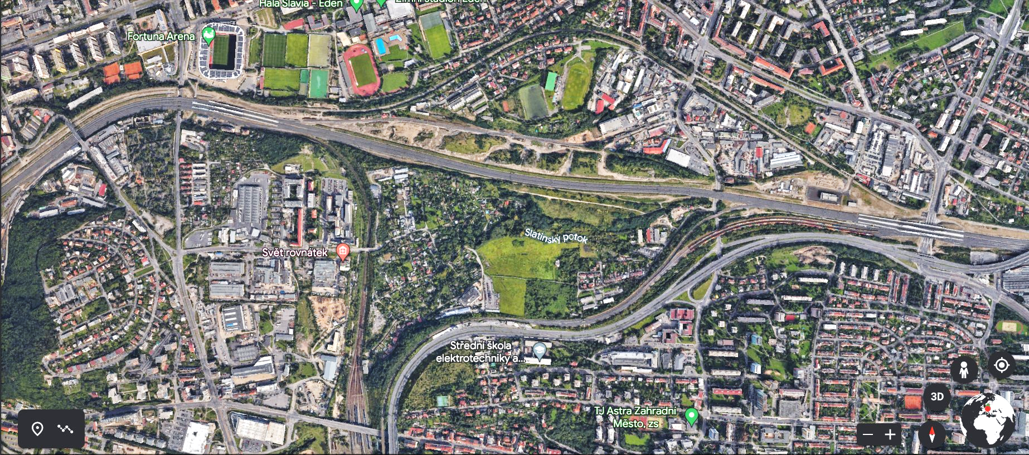

Slide 15
Slatiny belongs to one of the localities that is considered in more detail as part of the preparation of the Metropolitan Plan.
Due to their location, terrain configuration, important infrastructures delimiting their space, they are an isolated enclave, including in a social sense. Together with the wider surroundings, forming the "inner periphery", they are an ideal laboratory for formulating an urban vision of the transformation of this urban unit.

Slide 16
In what direction should the vision of similar hybrid territories be formulated?
preserve the unique character?
structure the territory with the classic typology of city blocks?
to be inspired by the spatial context and let the territory merge with the surroundings?
develop new concepts for a specific situation?
design a radically new city of the future?
how to optimize the availability of territory - infrastructure

Slide 17
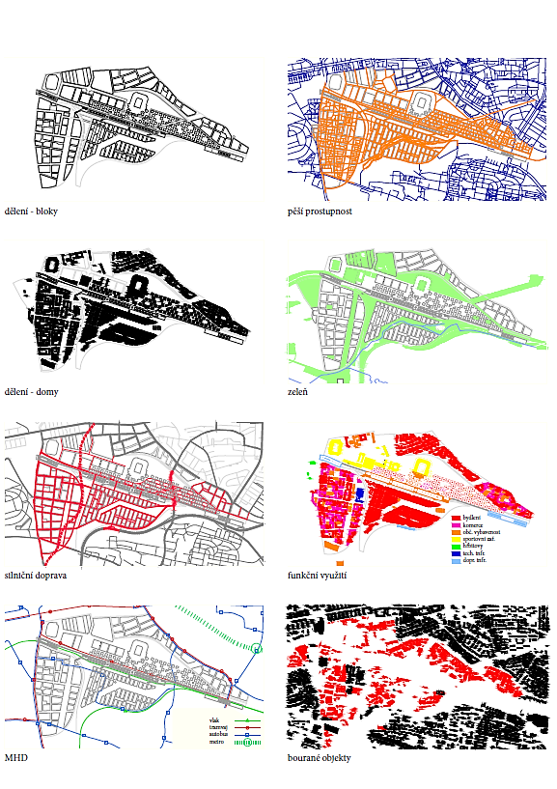

Slide 18
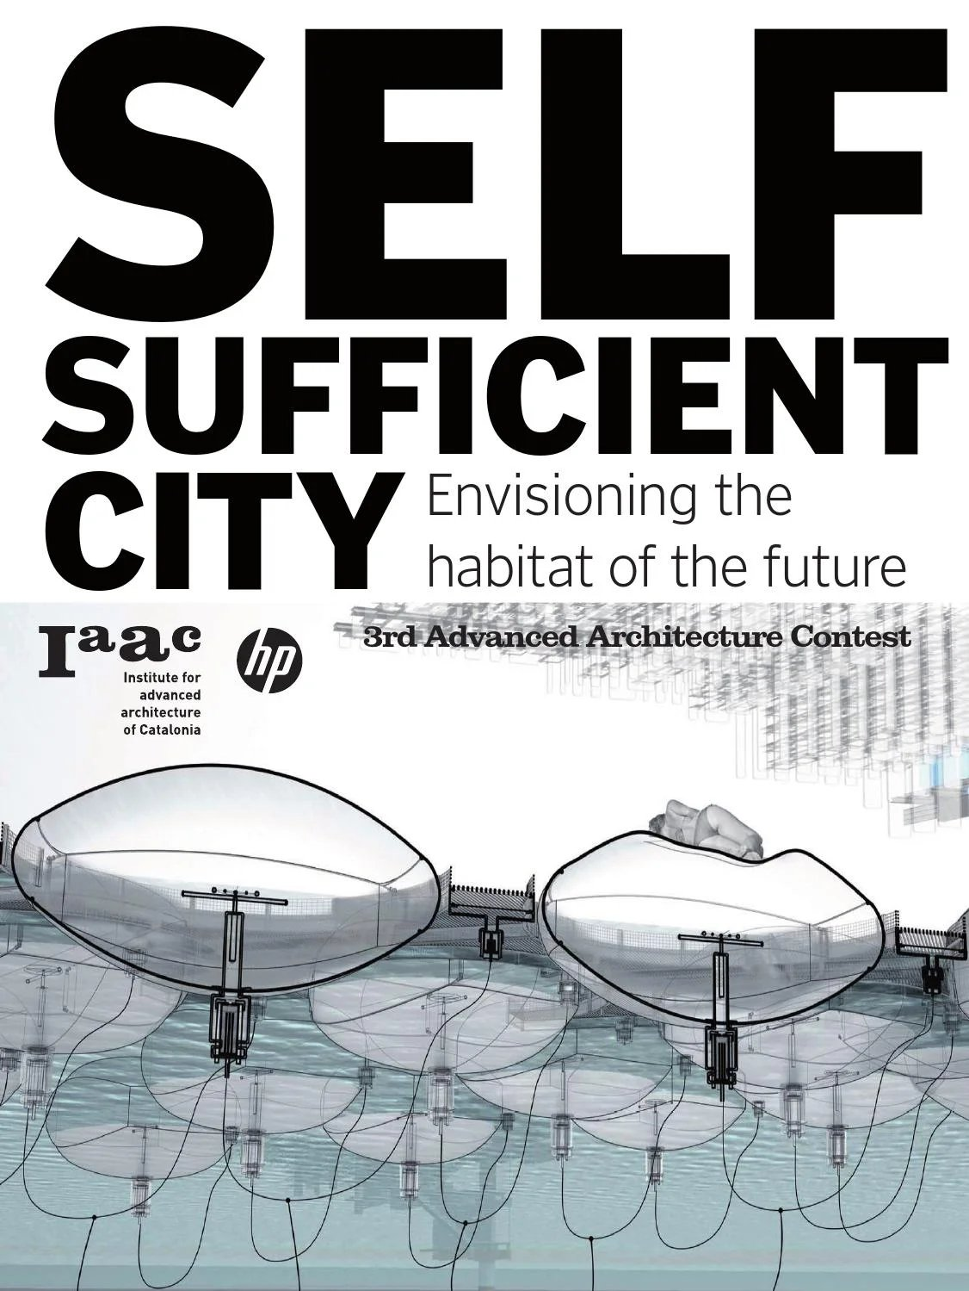
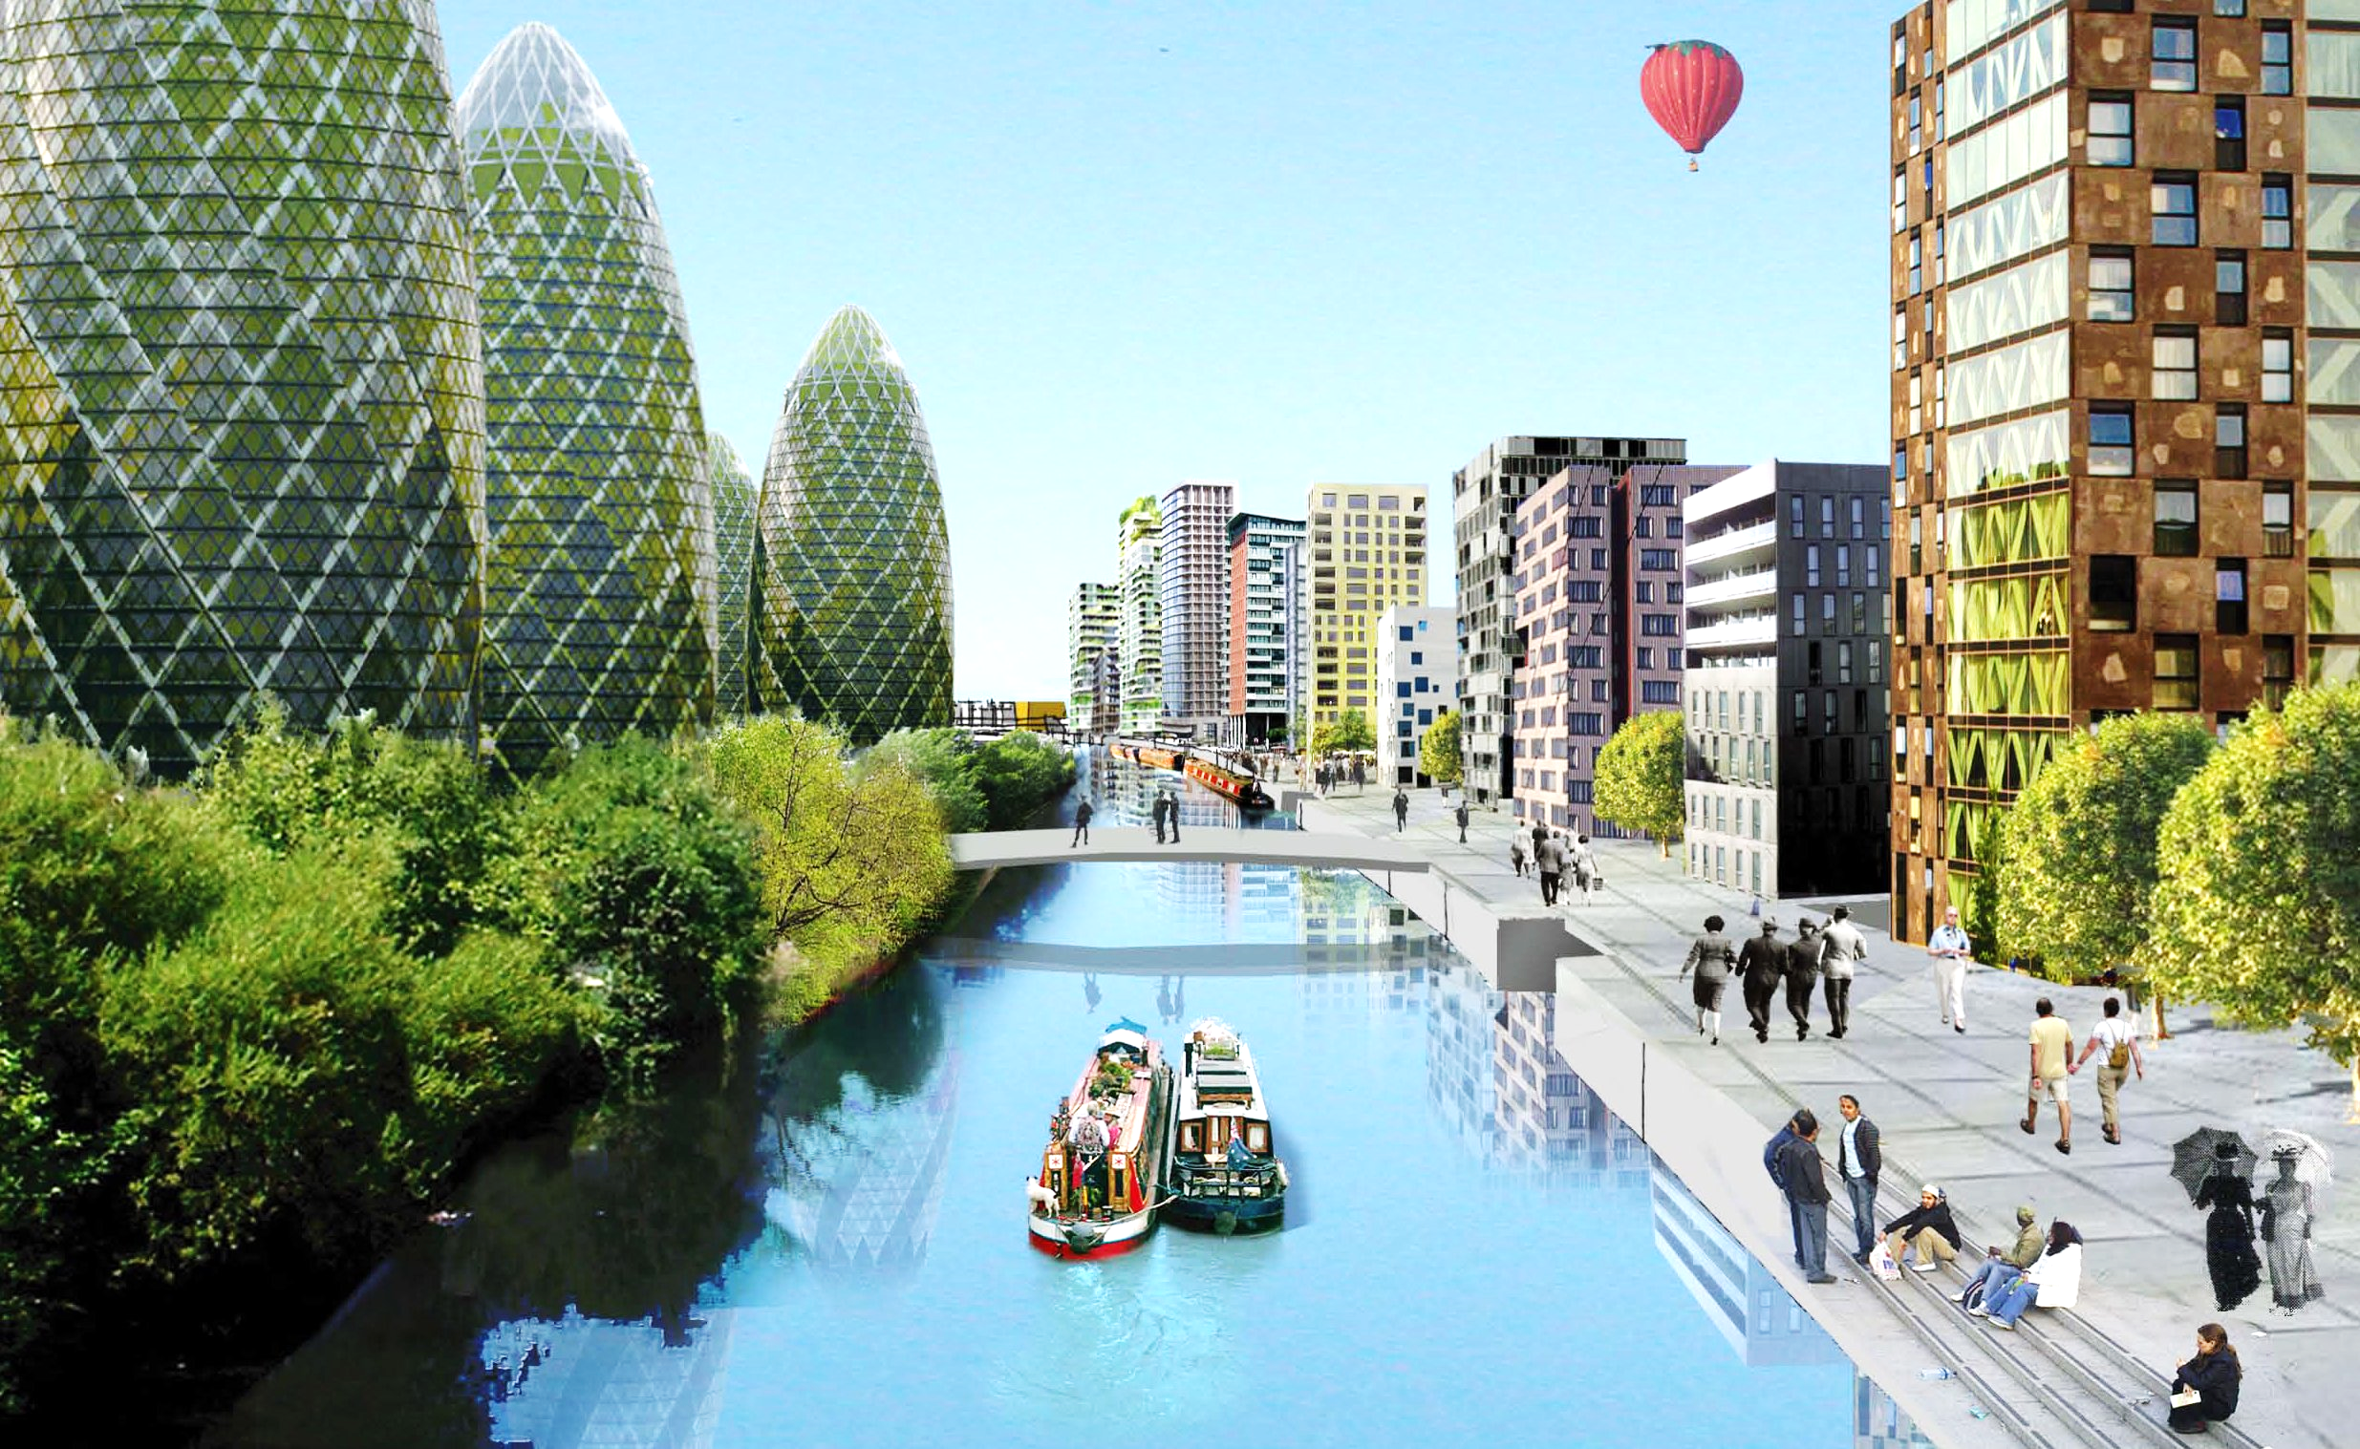
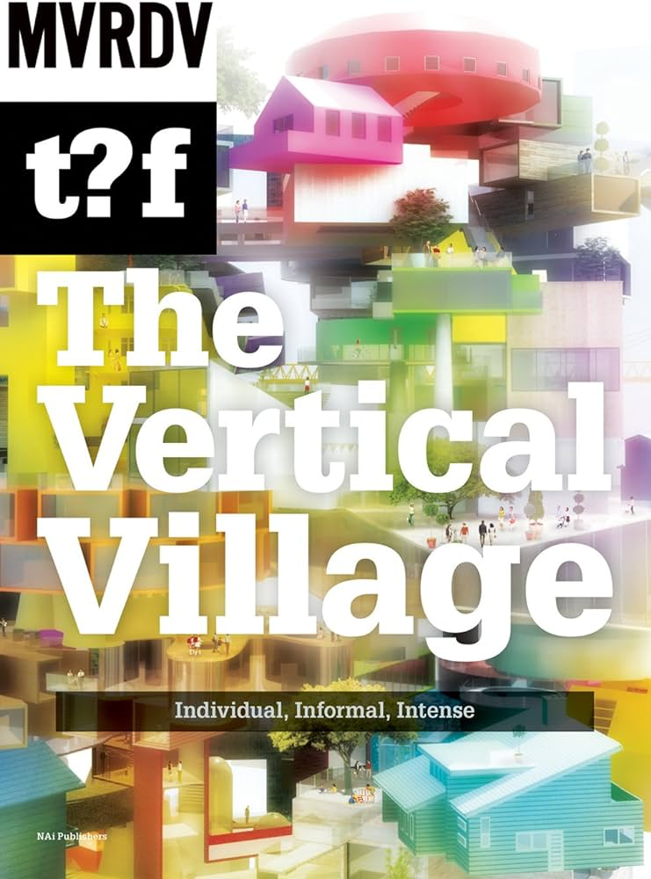

Slide 19
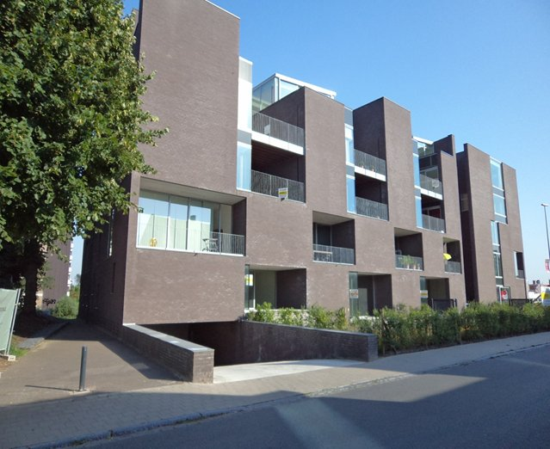

Slide 20
COOPERATION, CONSULTATION AND SUPPORT
Intercommunale Leiedal (IPR Kortrijk, Belgium)
FA KU Leuven (Belgium)
EU Brussels – New European Bauhaus (Belgium)

Slide 21
STUDIO KLOKOČKA – Institute of Urban Planning AND DESIGN
Jiri Klokočka, doc. Ing.arch., Akad.arch., Ir. (B) - jiri.klokocka@fa.cvut.cz
INFO: Monday 18.9.2023, at 5:00 p.m. and Thursday 21.9.2023, at 2:00 p.m., studio 643

