Slide 1
MILAN, NOVEMBER 2024

Slide 2
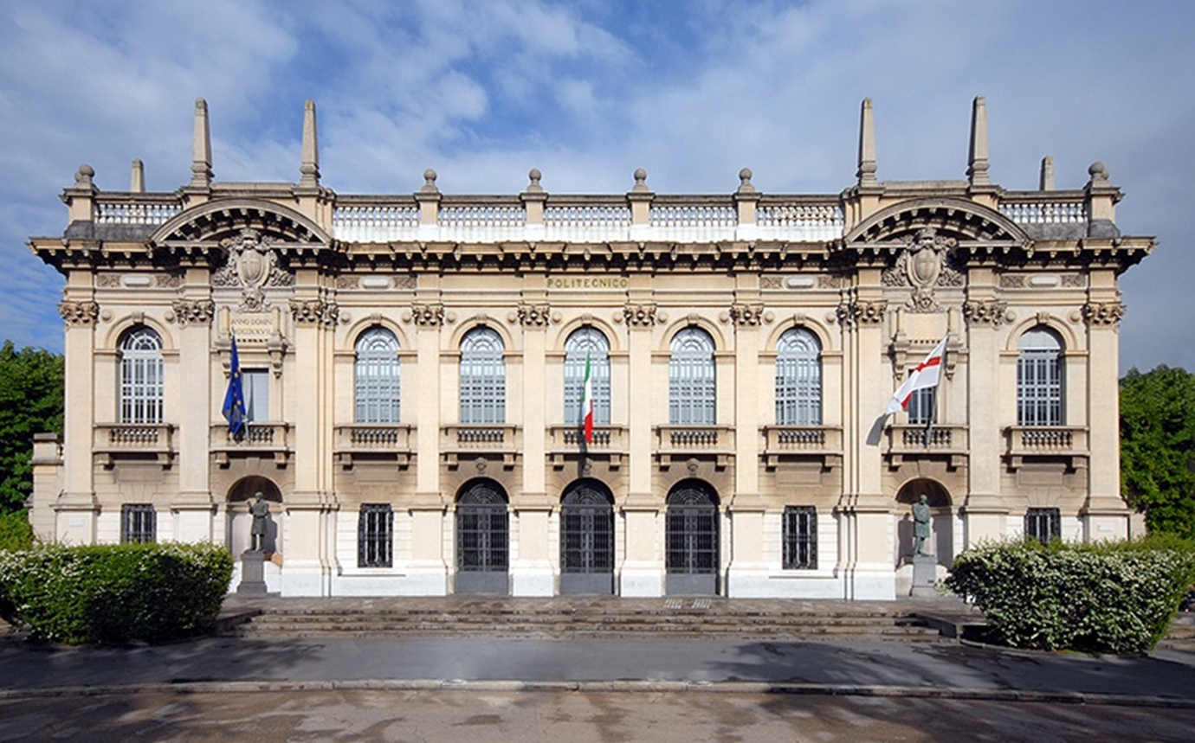
Politecnico di Milano: the leading University in Italy for Architecture, Design and Engineering
2

Slide 3
TECHNOLOGY
FOR
HUMANITY
For 162 years, passion for innovation at the service of the development of society and territory
Polimi Logo: From Raffaello’s fresco Euclid discussing with students
3

Slide 4
A COMMUNITY OF 50,000 PEOPLE
Professors & Researchers
Students
Architecture
400
8,500
(25% international)
Design
105
4,320
Engineering
987
35,672
4

Slide 5
12 DEPARTMENTS
Research activities are organised in 12 different Departments.
DEPARTMENT OF AEROSPACE SCIENCES AND TECHNOLOGIES (DAER)
DEPARTMENT OF ARCHITECTURE AND URBAN STUDIES (DASTU)
DEPARTMENT OF ARCHITECTURE, BUILT ENVIRONMENT AND CONSTRUCTION ENGINEERING (DABC)
DEPARTMENT OF CHEMISTRY, MATERIALS AND CHEMICAL ENGINEERING “GIULIO NATTA” (DCMC)
DEPARTMENT OF CIVIL AND ENVIRONMENTAL ENGINEERING (DICA)
DEPARTMENT OF DESIGN (DESIGN) DEPARTMENT OF ELECTRONICS, INFORMATION AND BIOENGINEERING (DEIB)
DEPARTMENT OF ENERGY (DENG)
DEPARTMENT OF MANAGEMENT, ECONOMICS AND INDUSTRIAL ENGINEERING (DIG) DEPARTMENT OF MECHANICAL ENGINEERING (DMEC) DEPARTMENT OF MATHEMATICS (DMAT)
DEPARTMENT OF PHYSICS (DFIS)
5

Slide 6
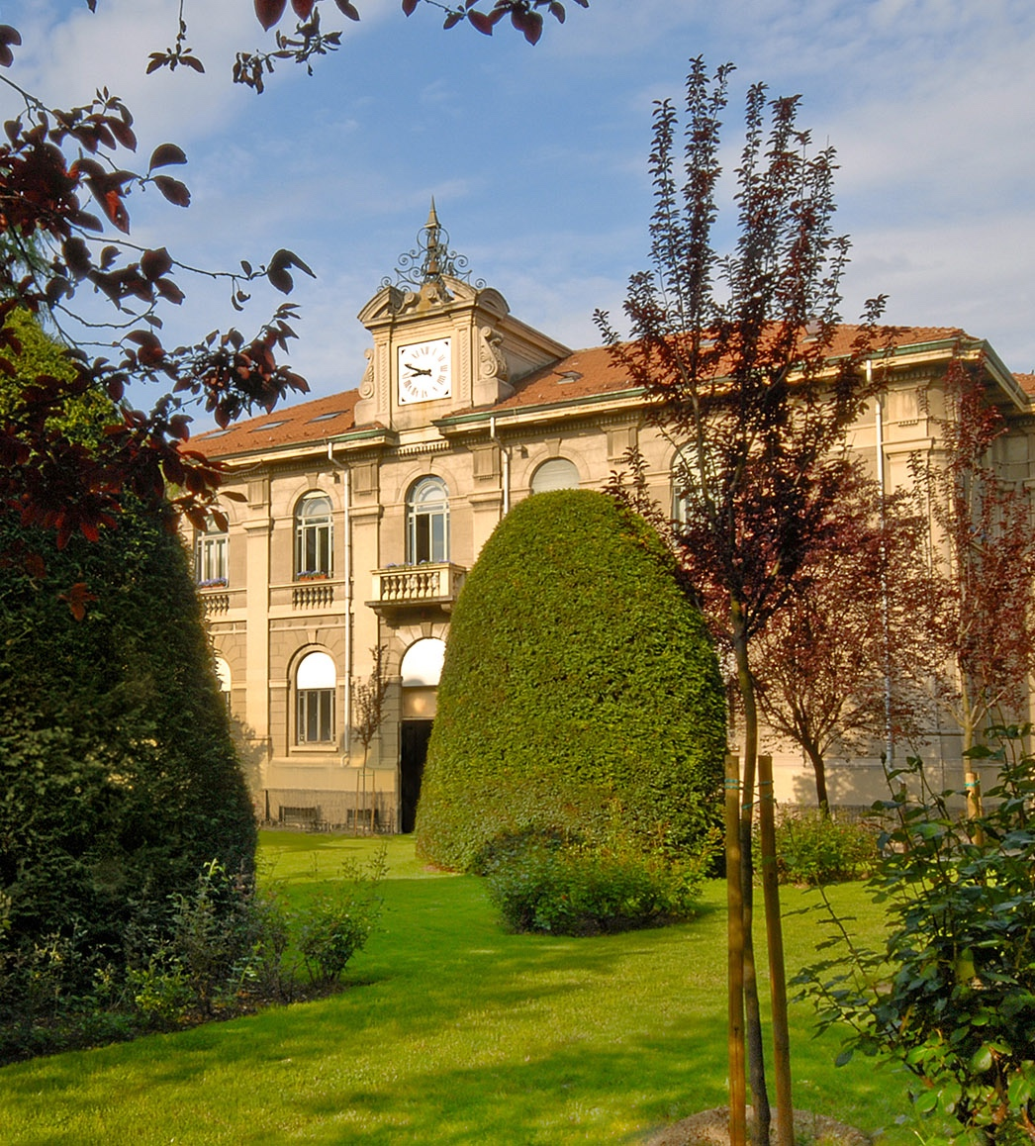
4 SCHOOLS
Architecture Urban Planning Construction Engineering (AUIC) Dean Andrea Campioli
Design
Civil, Environmental and Land Management Engineering
Industrial and Information Engineering
6

Slide 7
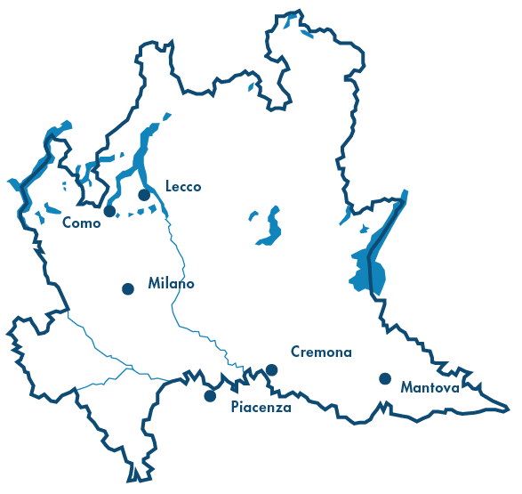
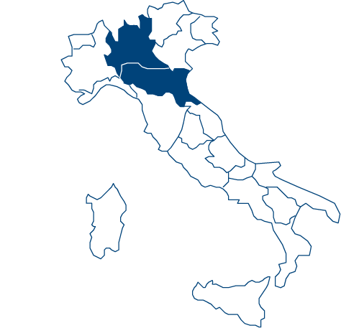
6 CAMPUSES IN NORTHERN ITALY
7

Slide 8
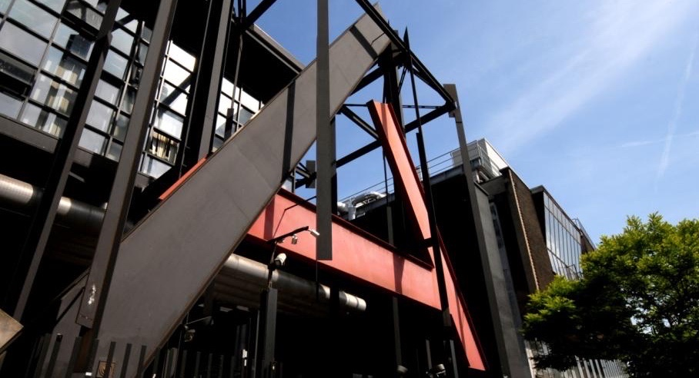
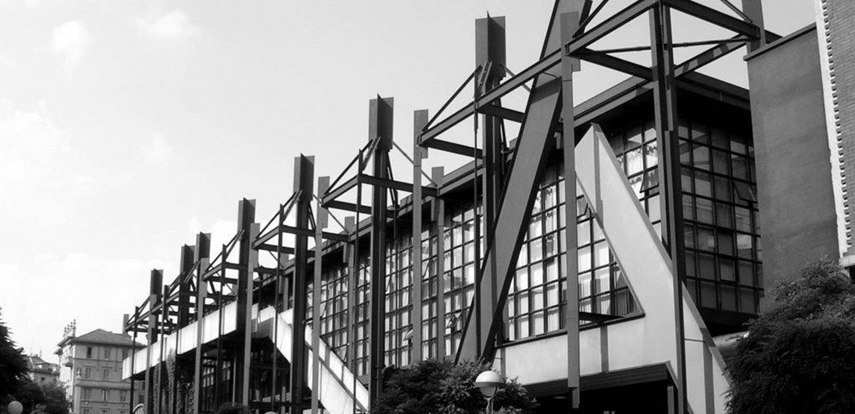

Slide 9
1st in Italy
5th in Europe
7th in the World
School of Architecture Urban Planning
Construction Engineering

Slide 10
IT’S NOT JUST ABOUT
TOP QUALITY EDUCATION.
IT’S ABOUT
ENHANCING
STUDENTS’ TALENT.

Slide 11
STARTING FROM THE INDIVIDUAL
Supporting the individual by facilitating opportunities for growth and talent, encouraging inclusion and promoting diversity, with particular attention to the passions and attitudes of each individual, as well as lifelong learning, for a development that must remain “human”. We ensure a environment that respects gender identities, different skills, cultures and backgrounds along five strategic lines of action: gender identity, culture, nation and religion, sexual orientation, different skills and psychological well-being.
We always listen to students in order to help them discover and enhance their talent and drive them toward a fulfilling professional future.

Slide 12
EMPLOYMENT OF GRADUATES MASTERS
97% gained employment within a year of graduating.
33% already had employment by their graduation day.
53% of foreign master’s degree graduates remained working in Italy.

Slide 13
THE GLOBAL UNIVERSITY OF ARCHITECTURE WITH MILAN LIFESTYLE

Slide 14
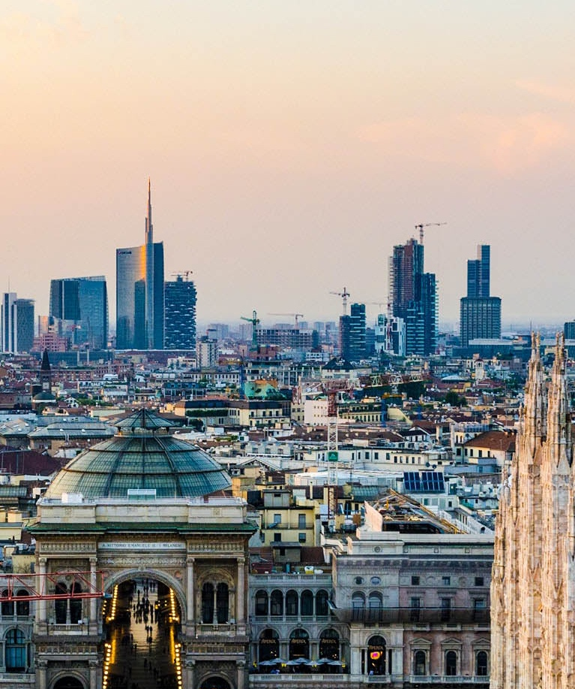
A BROAD HORIZON
A strong push towards internationalization is essential for a leading technical-scientific university in training and research operating in a global context.
Politecnico is based in Milan, a city that is open and international, welcoming and understanding drivers of change.

Slide 15
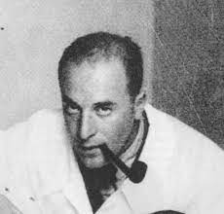
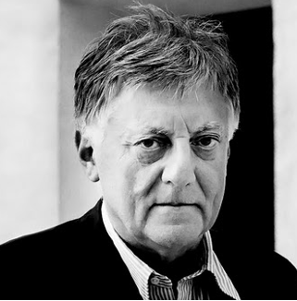
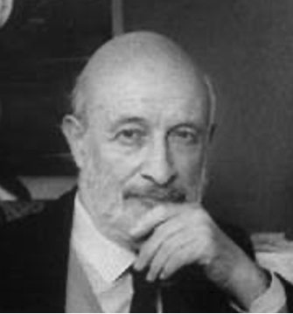
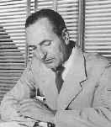
A BROAD HORIZON
Our culture is deeply rooted in the tradition of the Milanese School of Architecture, but keeps on contaminating with international point of views, thanks to lecturers and students with different backgrounds and everyday projects and activities inspired by the life and needs of the people of every corner of the world.
Ernesto N. Rogers
Aldo Rossi
Vittorio Gregotti
Ignazio Gardella

Slide 16
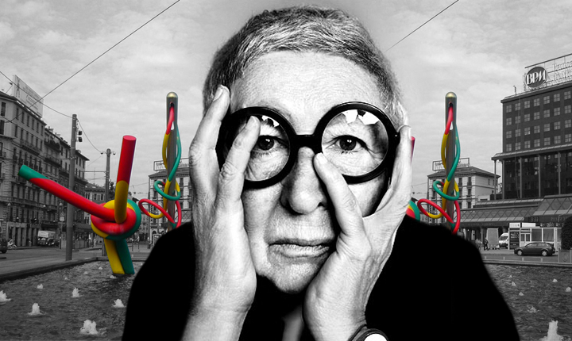
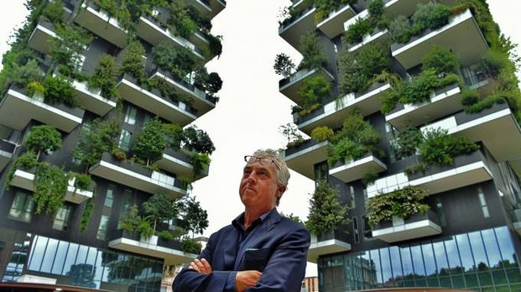
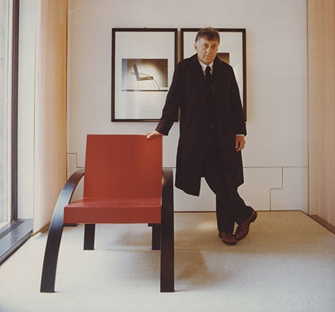
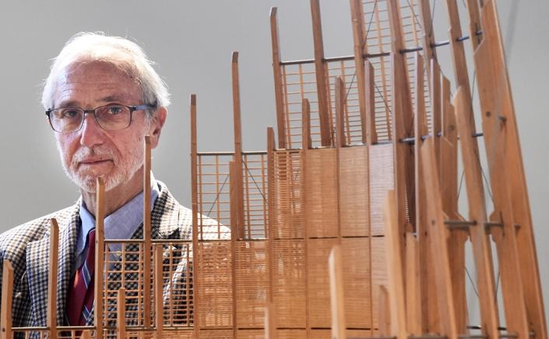
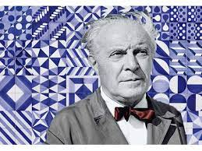
Alumni who gave their contribution to the Italian Tradition.
16

Slide 17
INTERNATIONAL COMMUNITY
Full Professors 100
Associate Professors 180
Researchers 120
Visiting Professor 50
Total enrolled students 8,500
Italian 75%
International 25% (72 countries) – but about 80-90% in the English track of the MSc Programmes
400/500 Exchange students every semester

Slide 18
MILAN: THE GLOBAL CAMPUS
An open, international university that feels “at home” both in Milan and across the world. An increasingly multicultural and humanistic approach to training, paired with an innovative digitalisation programme. A new concept of teaching which recognises the value of the experience gained during the past health crisis and redesigns classrooms and teaching methods accordingly (example collaborative classrooms).
Sustainable development of spaces that takes into account needs relating to liveability, study and socialising.

Slide 19
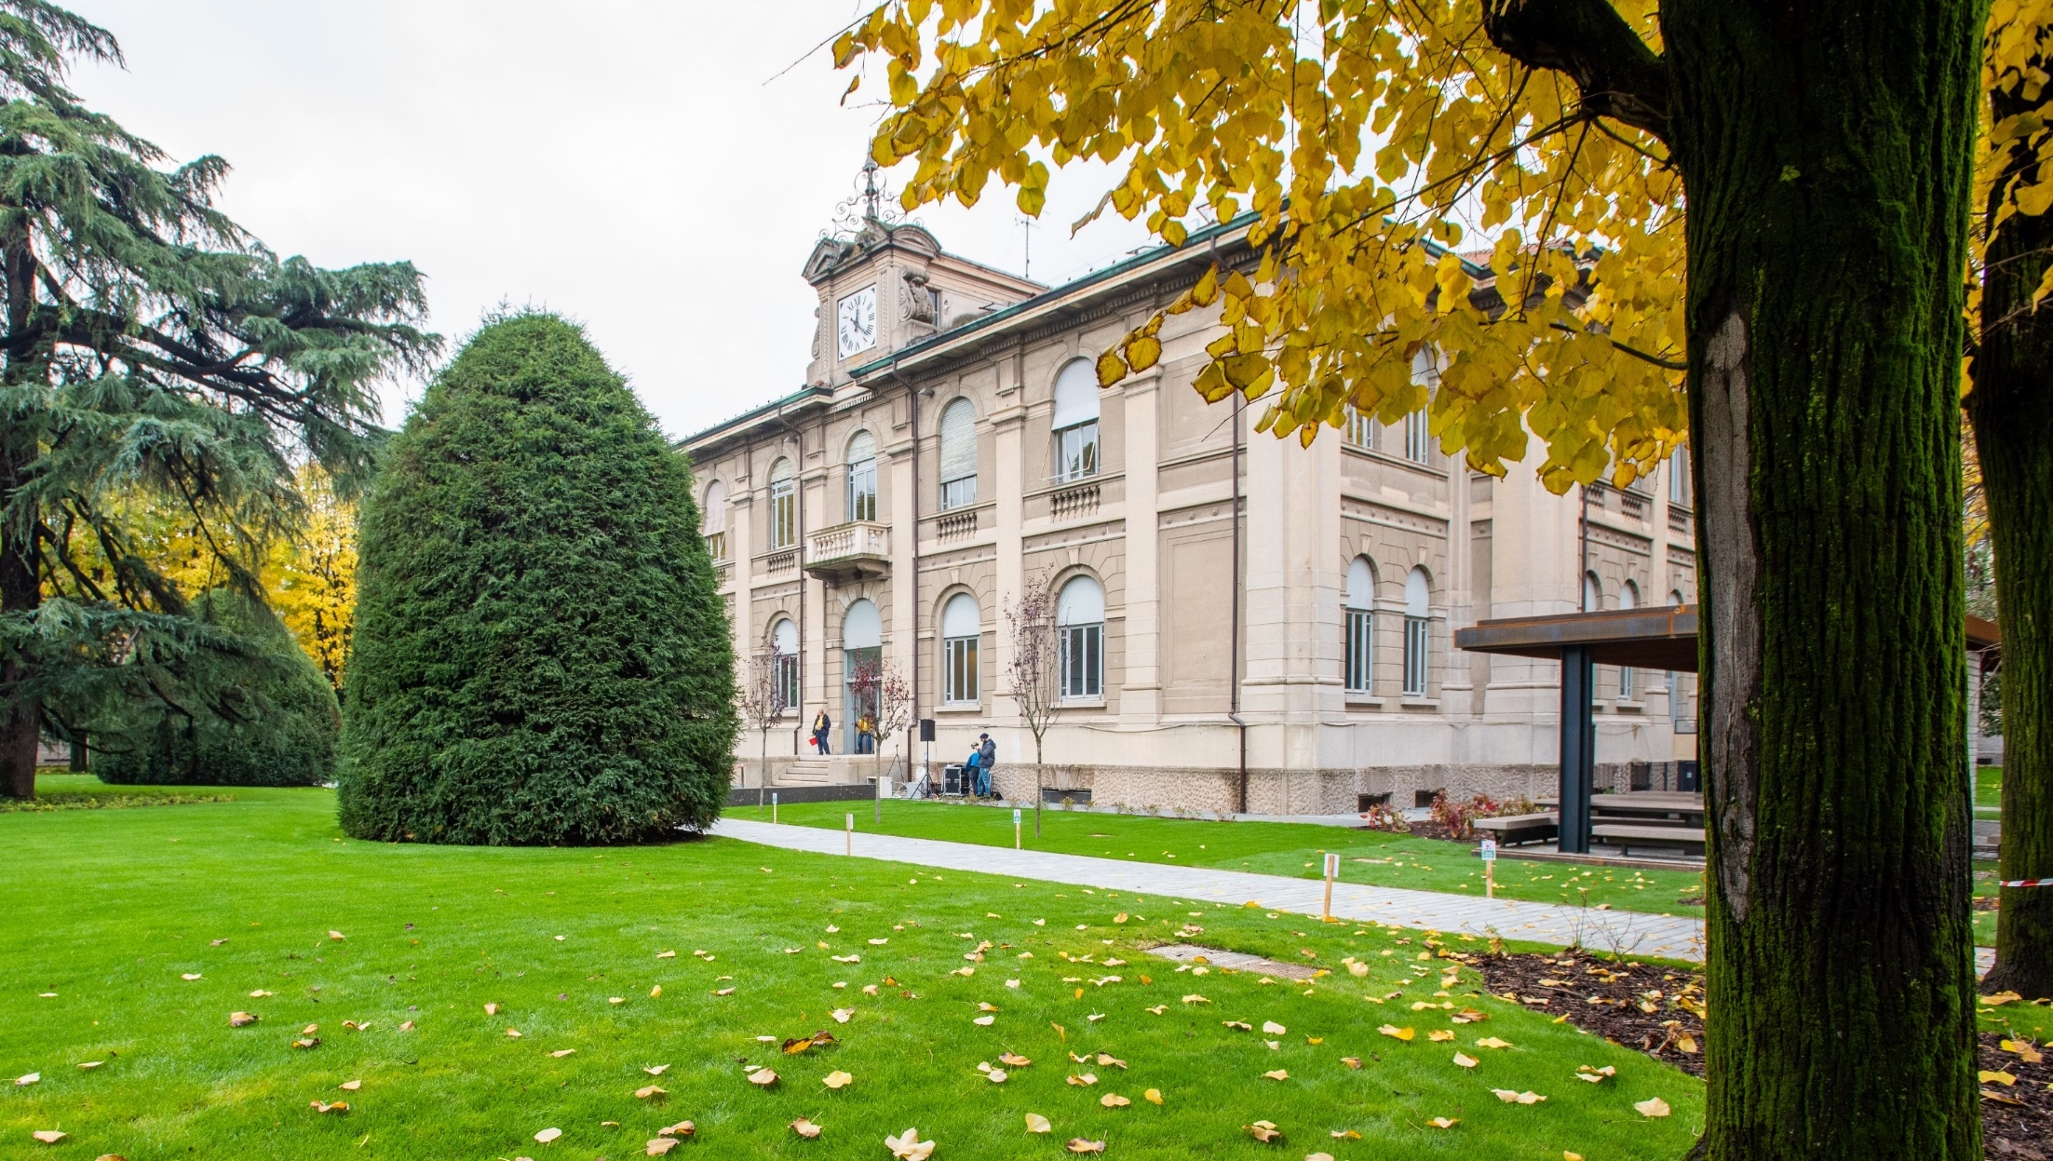
SUSTAINABLE CAMPUS
Renewing the Leonardo Campus (where the Double Degree programmes is carried out) in a sustainable way to transform the university area into a role-model for the city in terms of quality of life and environmental sustainability.
Taking a holistic view to addressing the new challenges of health and well-being.
New green areas
De-paved open spaces with high-quality materials
Outdoor work & study opportunities
…
19

Slide 20
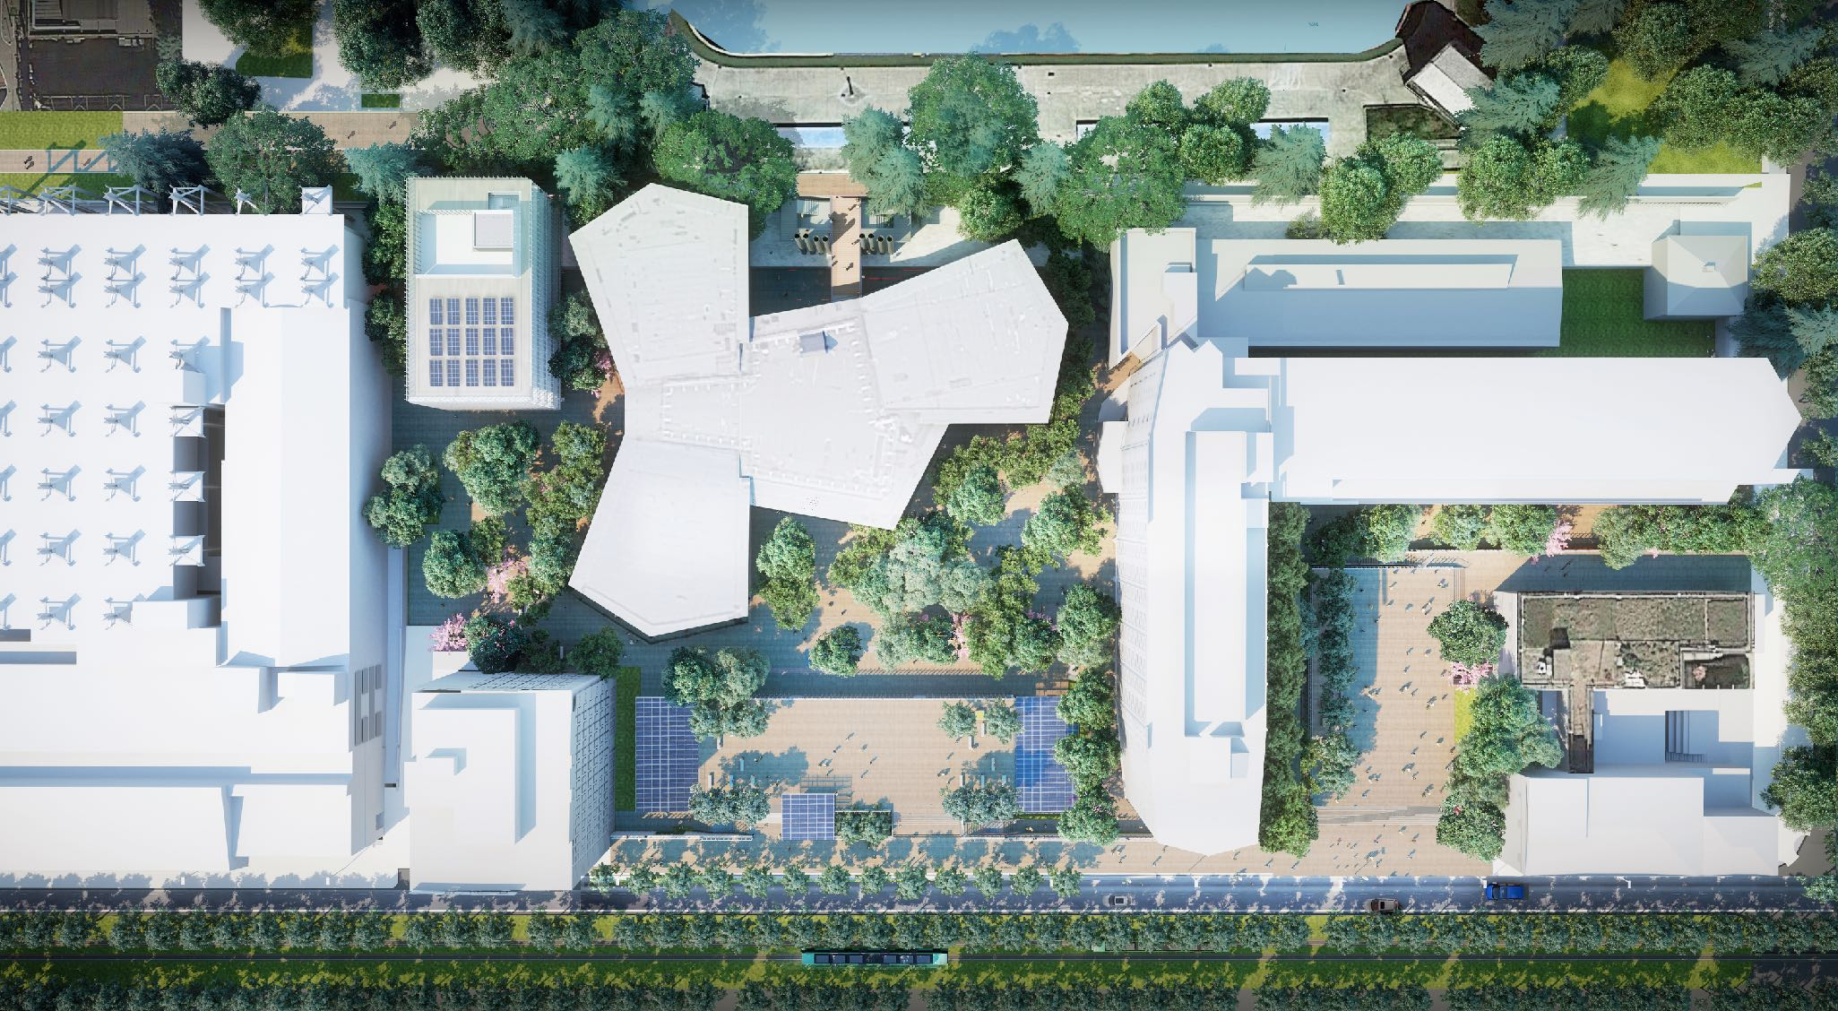
THE NEW LEONARDO CAMPUS

Slide 21
Renzo Piano’s
original idea in 2015

Slide 22
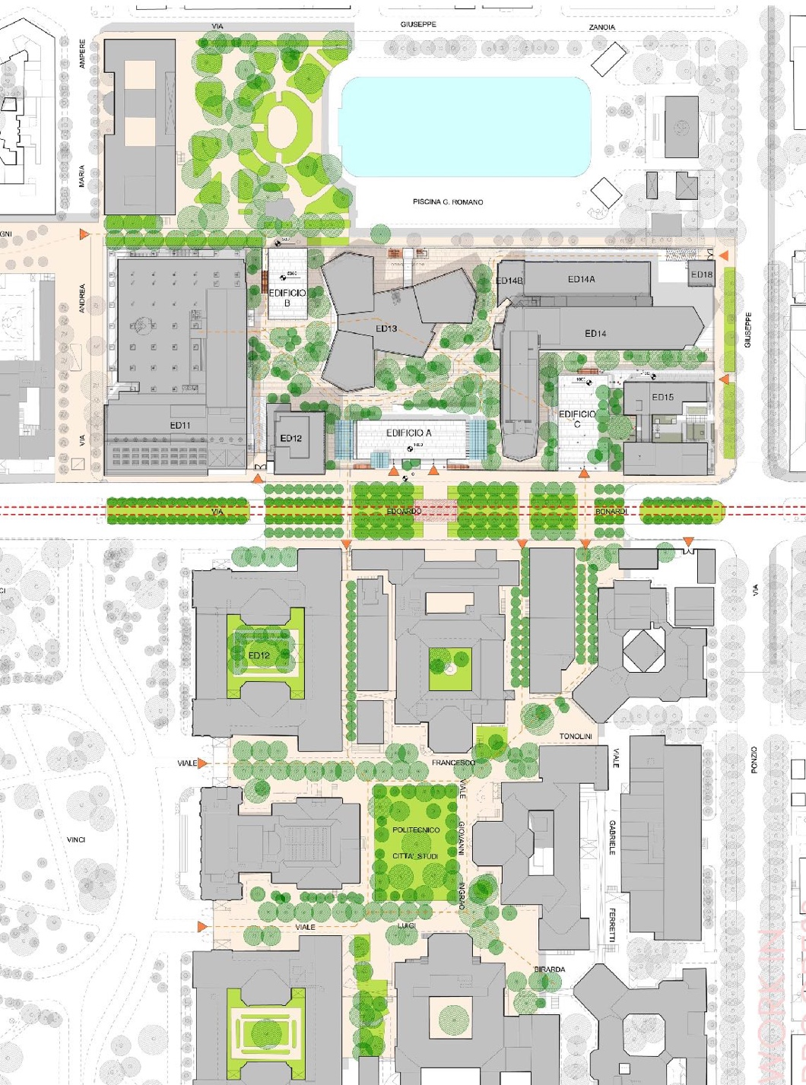
Connecting the existing, separate green spaces

Slide 23
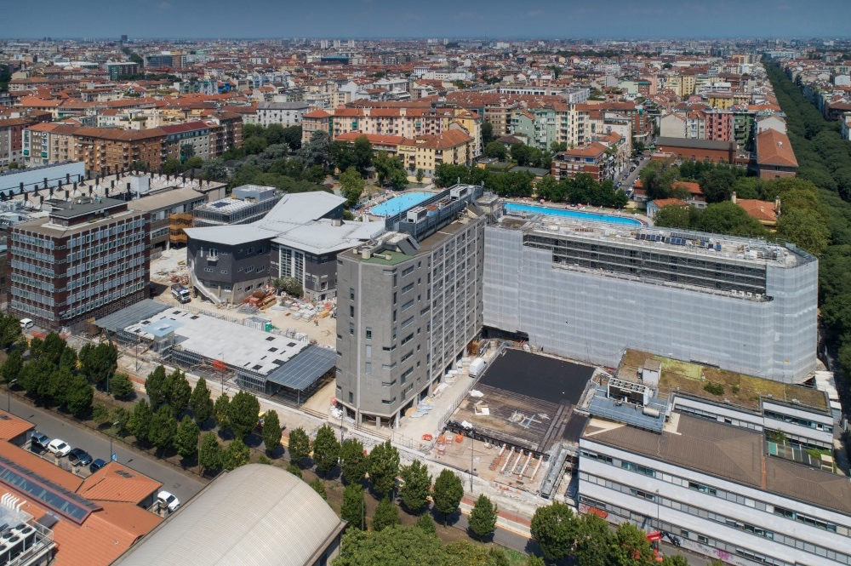

Slide 24
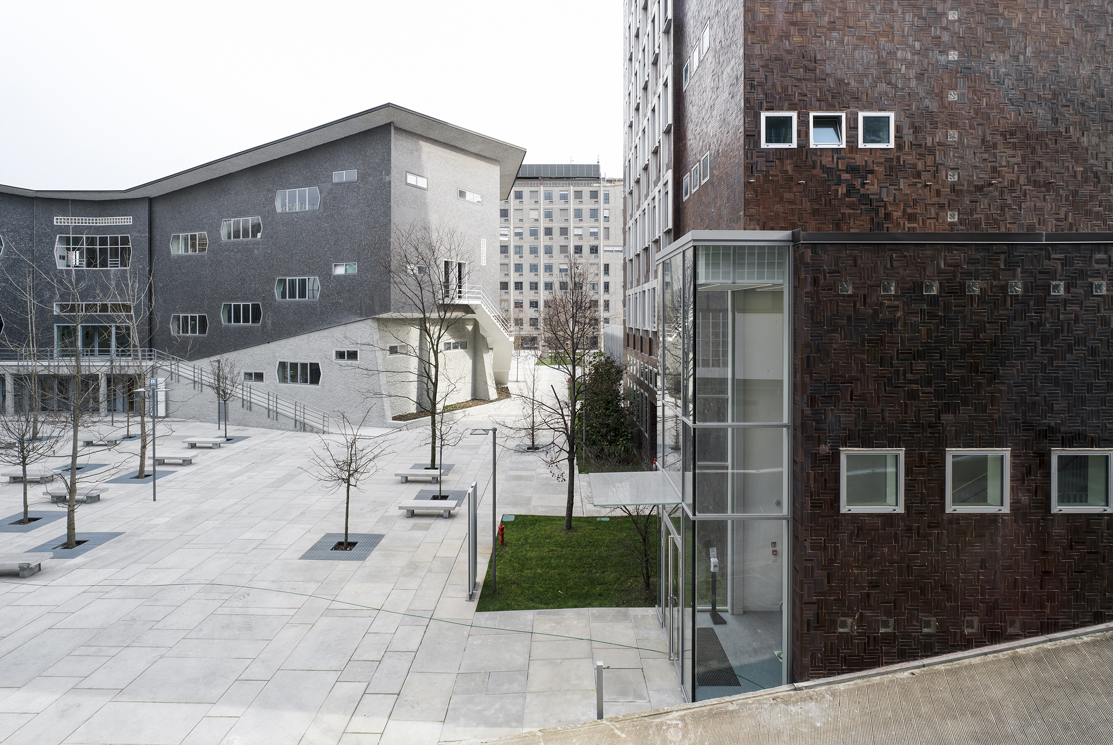

Slide 25
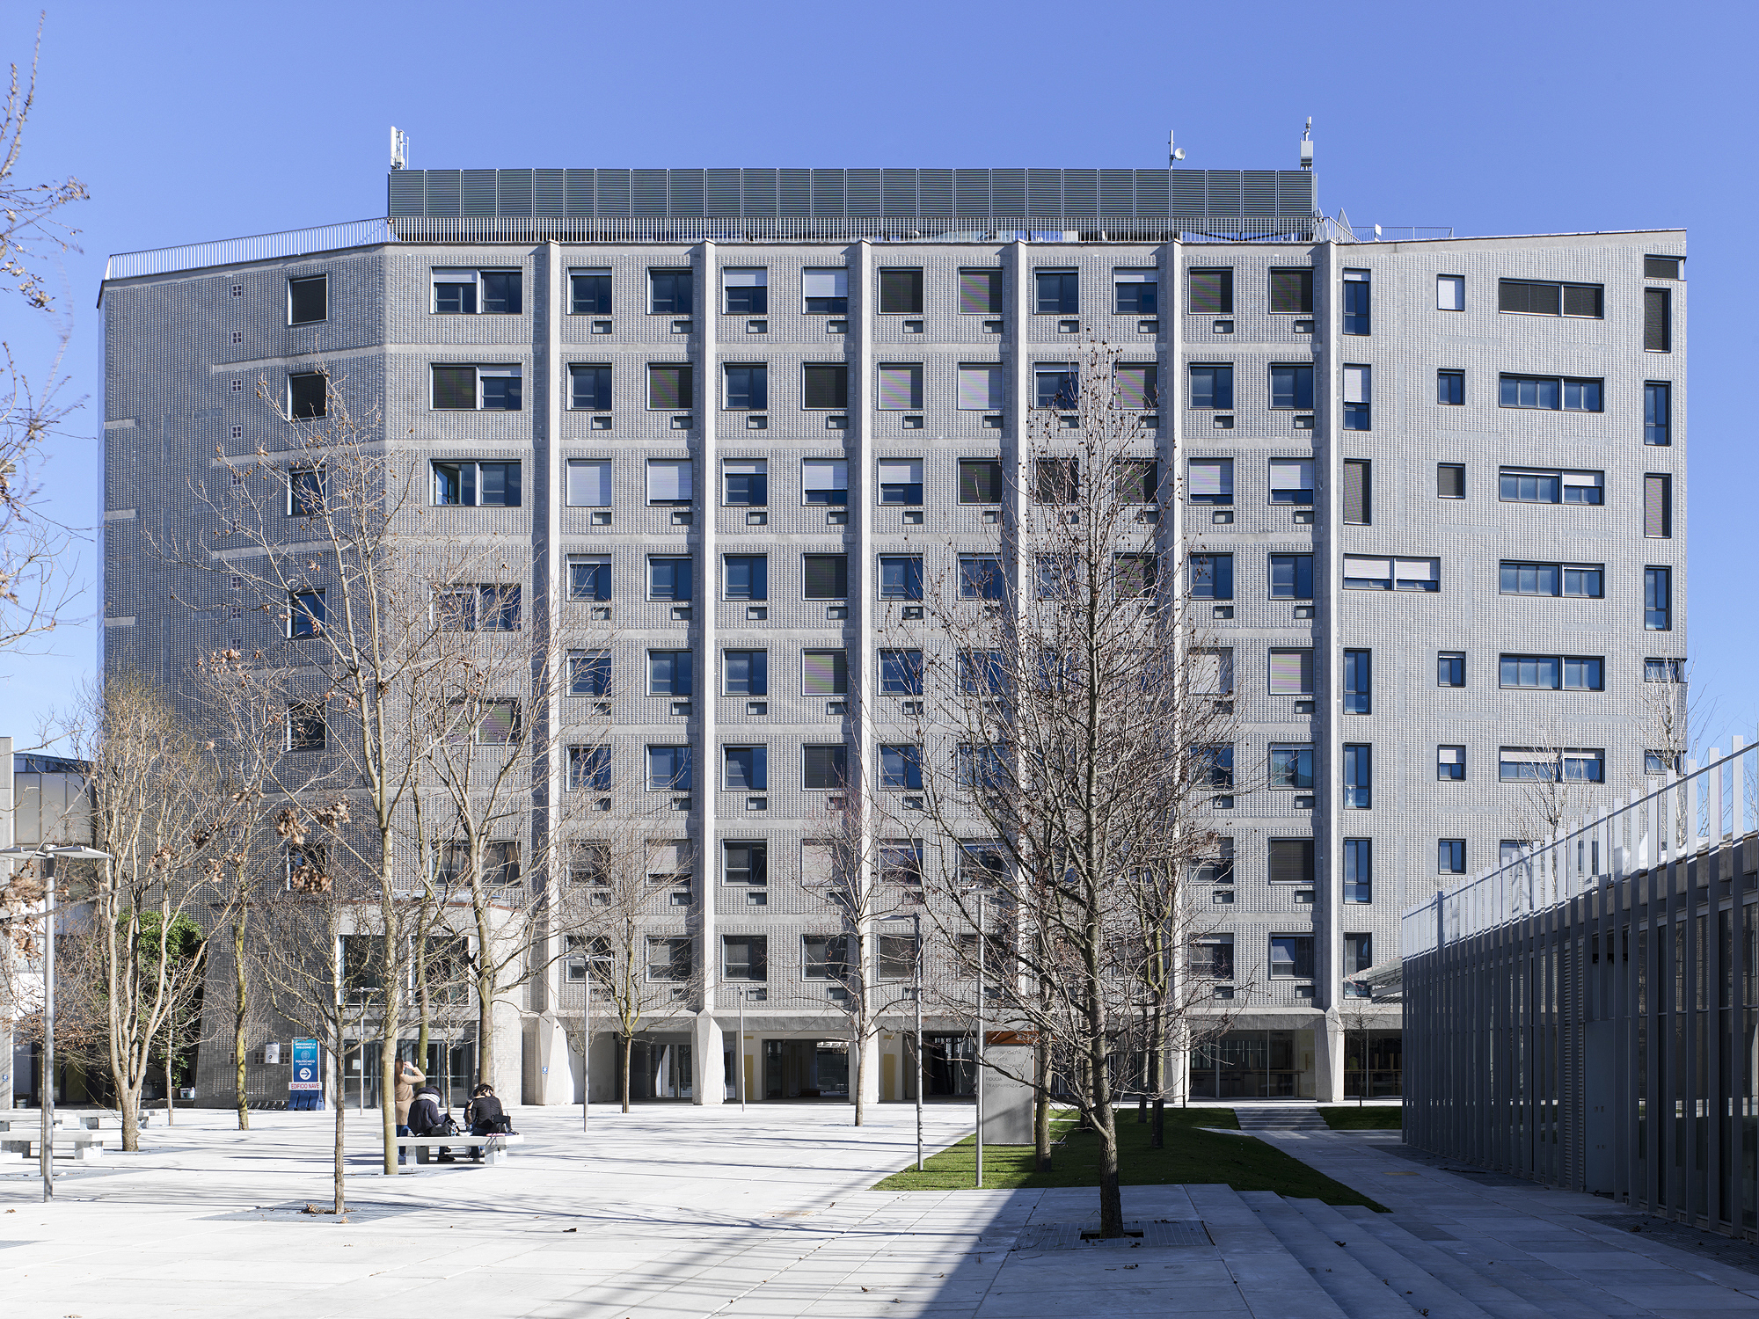

Slide 26
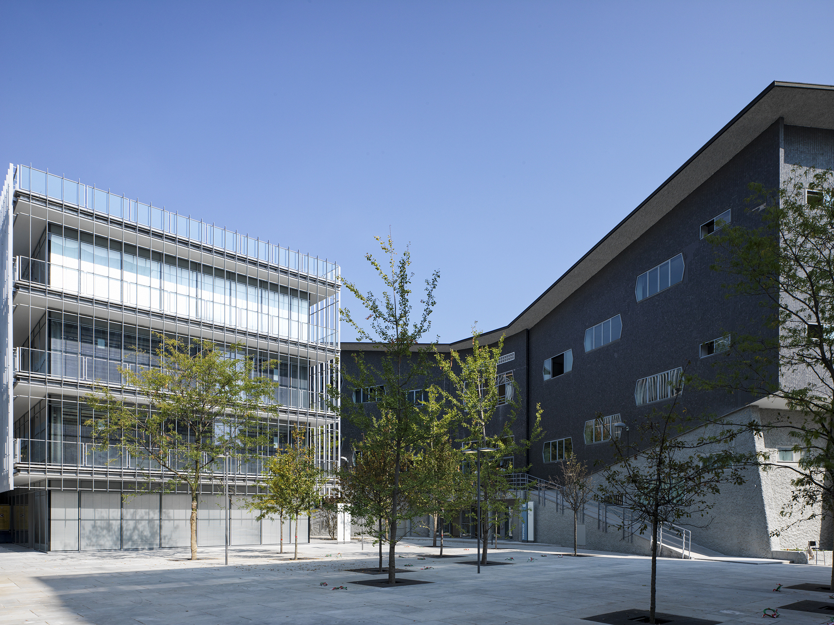

Slide 27
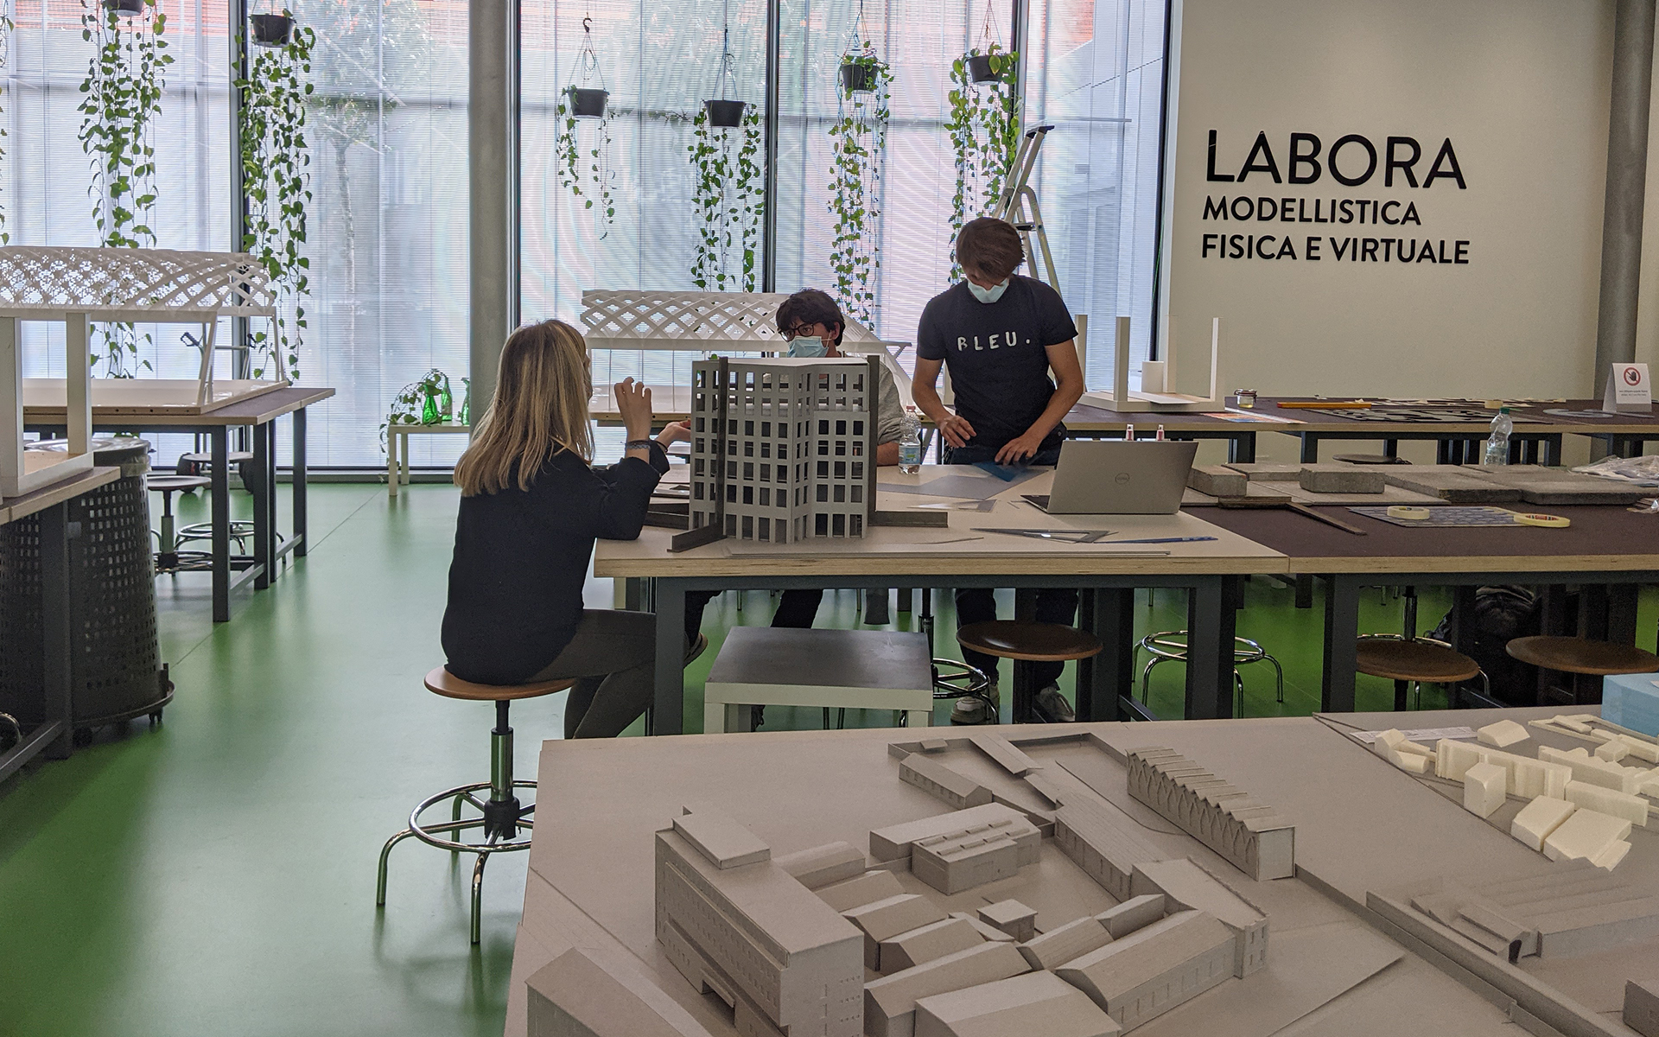

Slide 28
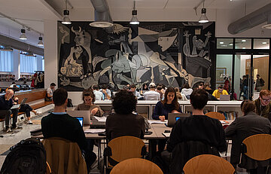

Slide 29
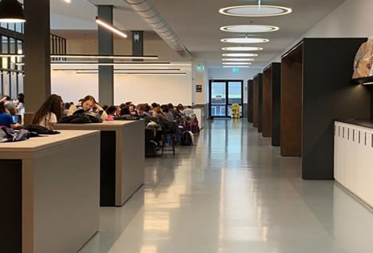
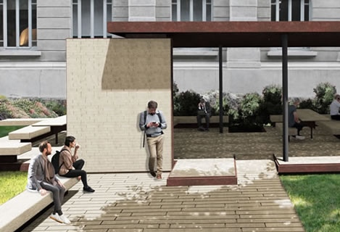
VIVIPolimi is a project to improve the quality of Politecnico’s spaces.
Some of the most relevant interventions are the new “Students’ agora” in the main Architecture building and the improvement of open spaces in the historic Leonardo campus.

Slide 30
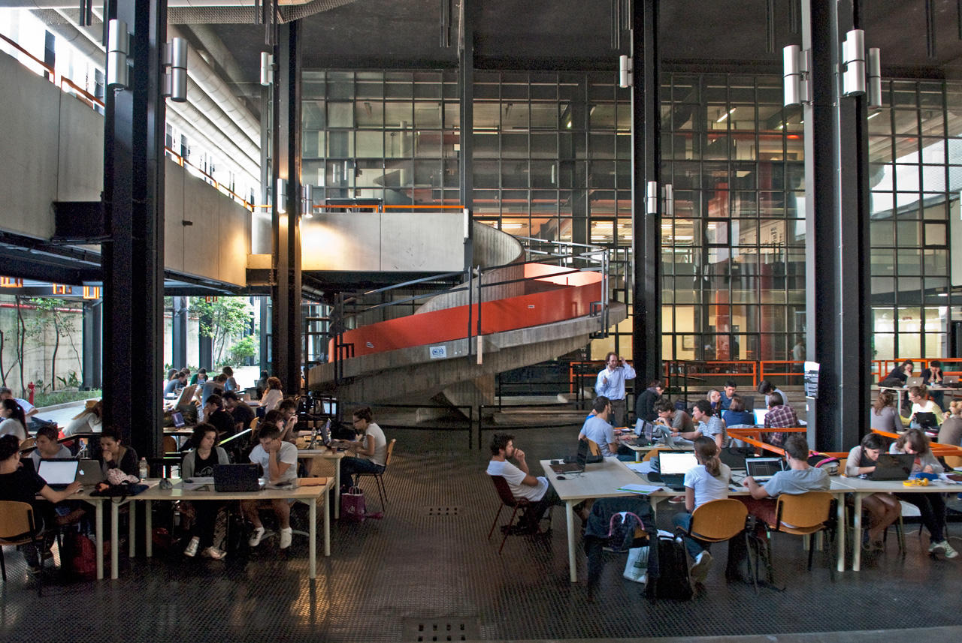

Slide 31
THE DOUBLE DEGREE
WITH THE
MASTER OF SCIENCE
IN ARCHITECTURE

Slide 34
To gain the Italian Diploma within the Double Degree Programme,
students from CTU Prague need to achieve: - 150 credits include thesis and internship - 60 credits of teachings at Polimi selected within the programme of the following Masters: Master in Architecture 1° year, Master in Architecture and Urban Design and Architecture – Built Environment – Interiors 2° year (for ay 2025/26 only) - work on a thesis with 2 supervisors (1 from Polimi and one from CTU) - defense the thesis both at Polimi and at CTU
- Professor Domenico Chizzoniti is your referent for the academic path
- The Double Degree programme is carried out in the Leonardo Campus, MIlan

Slide 35
COURSES FROM THE FIRST YEAR OF THE PROGRAMME:
NEW MASTER IN ARCHITECTURE - 4 TRACKS
Milano Leonardo Campus
- Architecture and Interior Space
- Architecture and Urban Design
- Architecture, Heritage and Built Environment
- Architecture and Environment

Slide 36
COURSES FROM THE SECOND YEAR OF THE PROGRAMME :
MASTER IN ARCHITECTURE - BUILT ENVIRONMENT – INTERIORS
Milano Leonardo Campus
The Programme provides advanced training in the field of Architectural Design with the aim to graduate practitioners able to change and to transform the built environment in its physical, architectural elements, empowering architectural resilience and affordance. The focus is on the regeneration of urban fabric, as well as of fragile territories, on interventions of building extensions and transformation, restoration and enhancement.
Programme of the Courses
ihttps://www4.ceda.polimi.it/manifesti/manifesti/controller/ManifestoPublic.do

Slide 37
COURSES FROM THE SECOND YEAR OF THE PROGRAMME :
MASTER IN ARCHITECTURE AND URBAN DESIGN
Milano Leonardo Campus
The programme provides an advanced training in the field of Architectural Design and develops design competences based on the Italian tradition, facing different housing cultures, the new forms and spaces of contemporary cities, the development of new urban settlements in developing countries, the innovation in building techniques and environmental sustainability.
Programme of the Courses
https://www4.ceda.polimi.it/manifesti/manifesti/controller/ManifestoPublic.do
37

Slide 38
THE POLITECNICO FULFILLING EXPERIENCE

Slide 39
EXTRA CURRICULAR ACTIVITIES
EXHIBITIONS AT THE GALLERIA DEL PROGETTO
SEMINARS - LECTURES
ARCH WEEK
STUDY TRIPS
CULTURE AND SPORTS

Slide 40
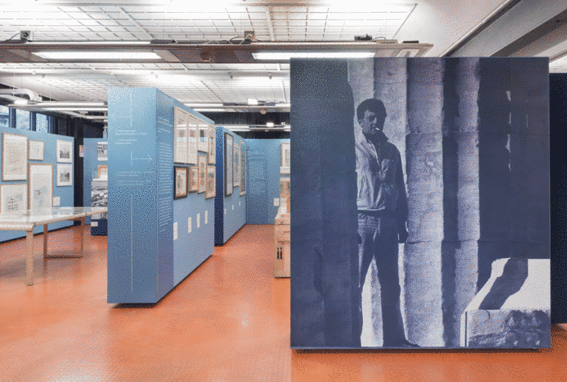
Aldo Rossi. Il Gran Teatro dell'Architettura

Slide 41
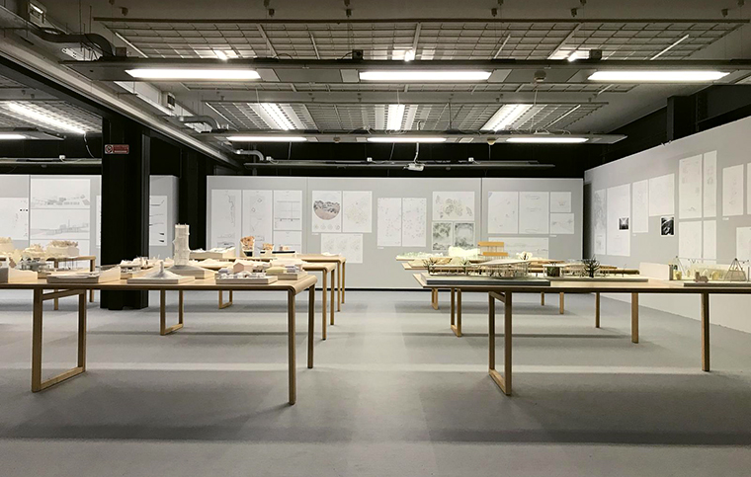
Inujima: Architecture becomes Environment
Kazuyo Sejima

Slide 42
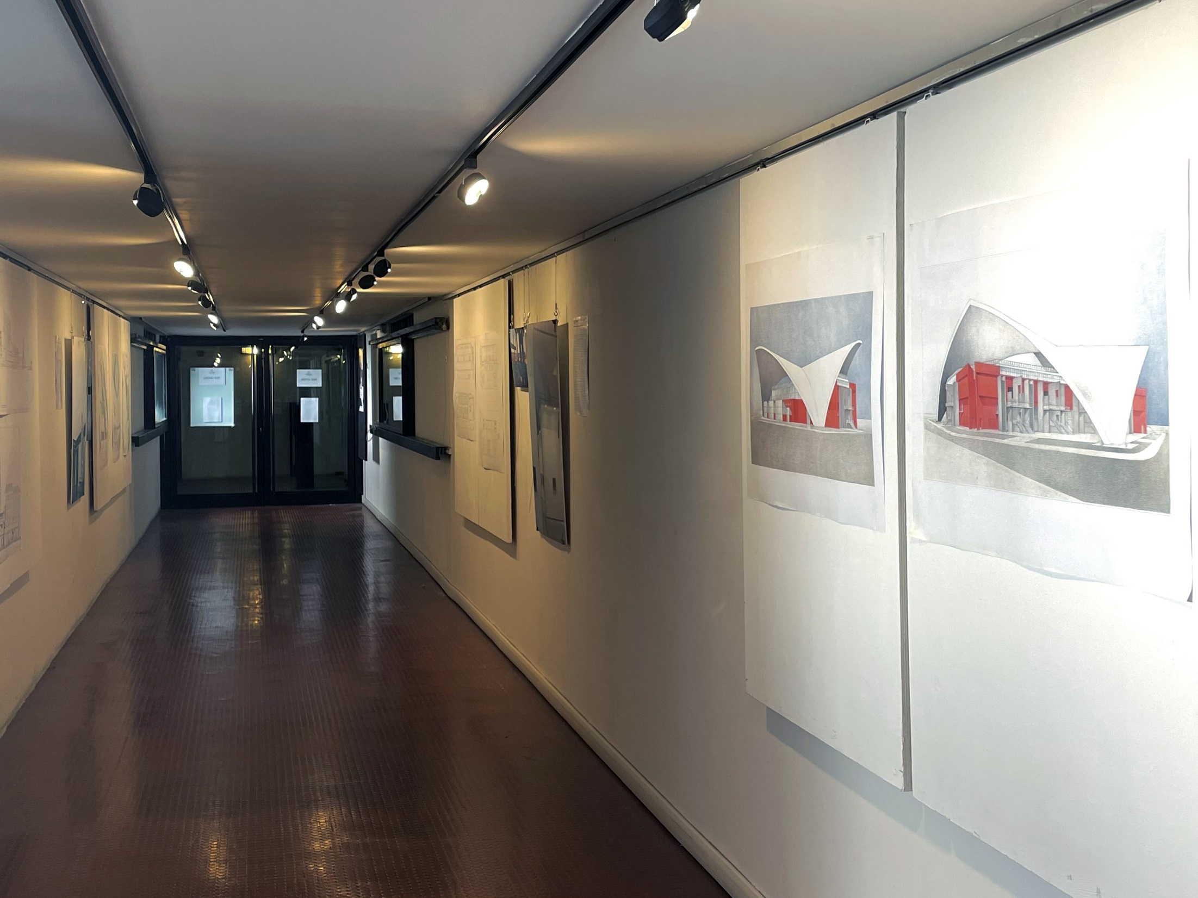
Gae Aulenti. City open artwork

Slide 43
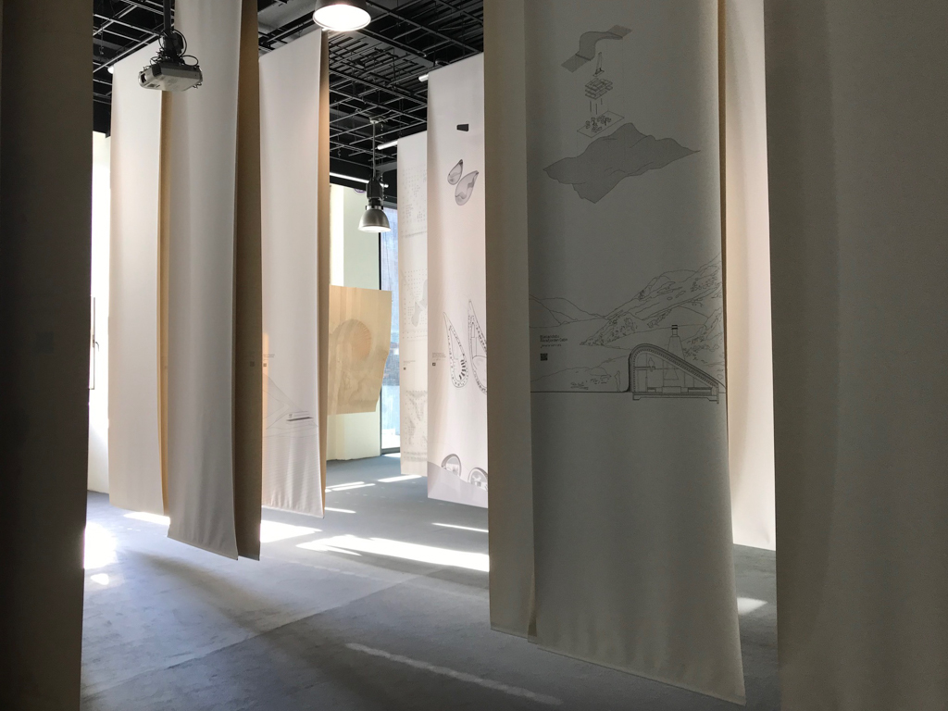
Arctic-Nordic-Alpine – Studio Snøhetta

Slide 44
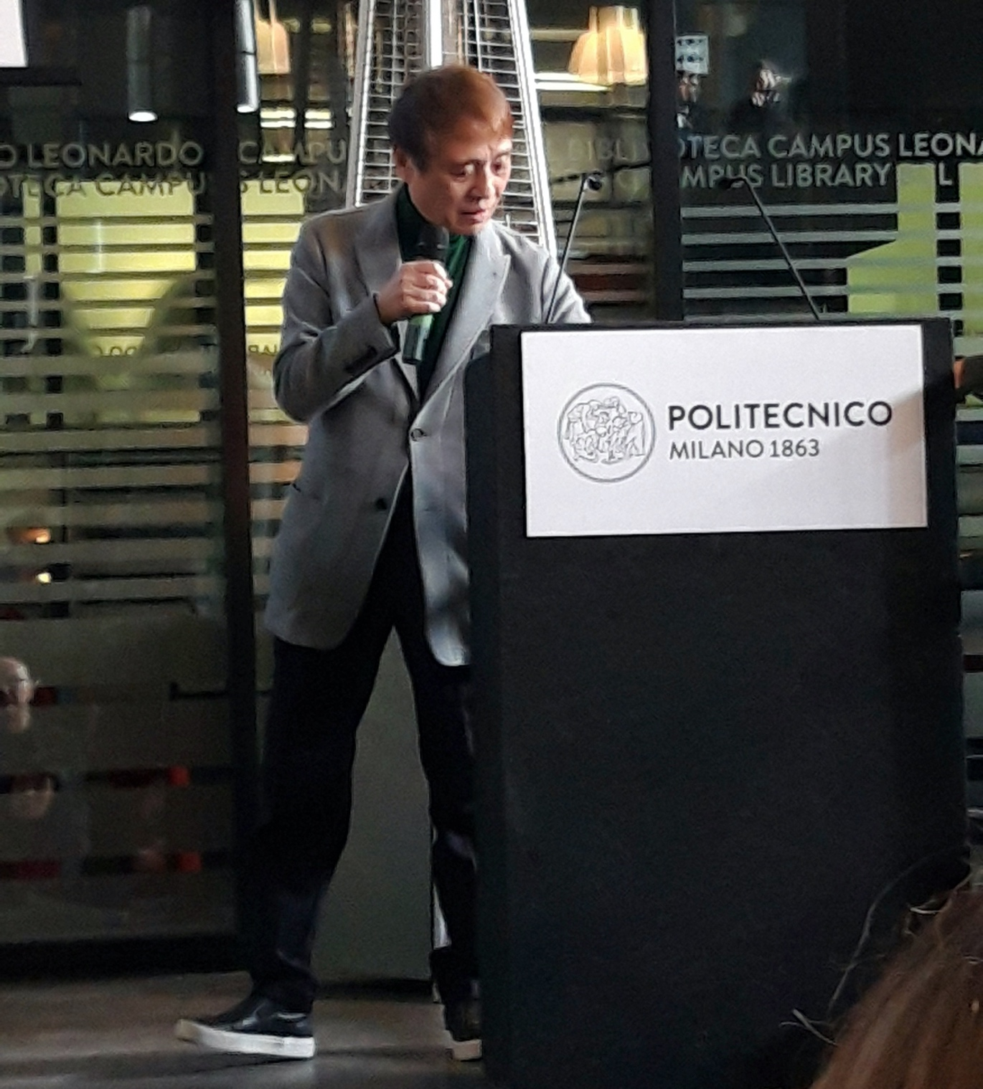
Tadao Ando,
lecture in the Patio

Slide 45
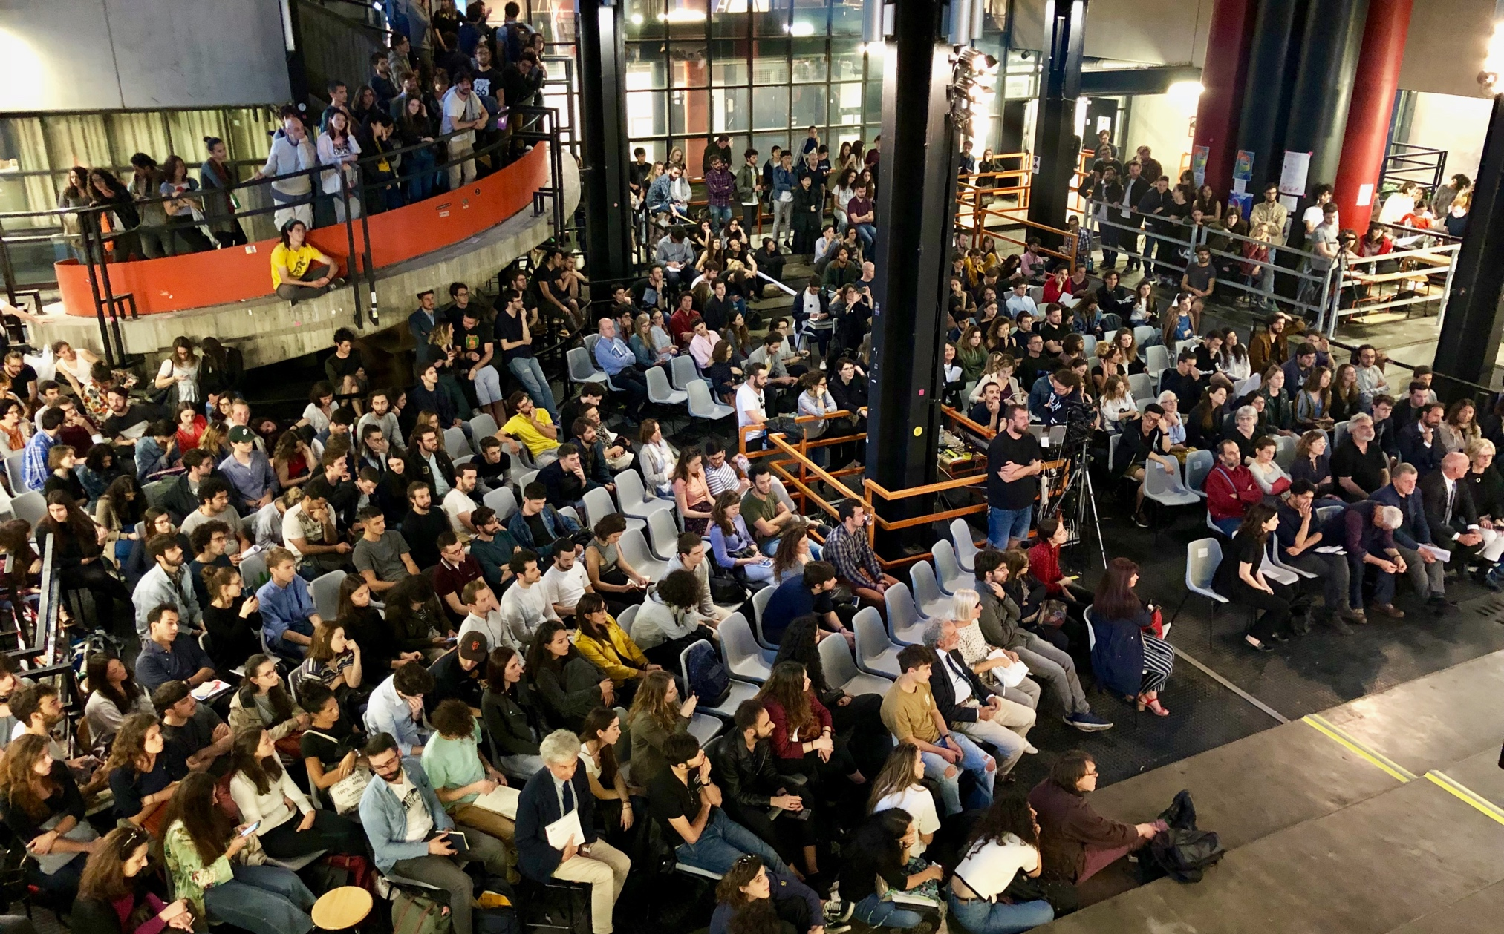
Milano Arch Week takes place in spring with several conferences and debates involving world-class architects and designers

Slide 46
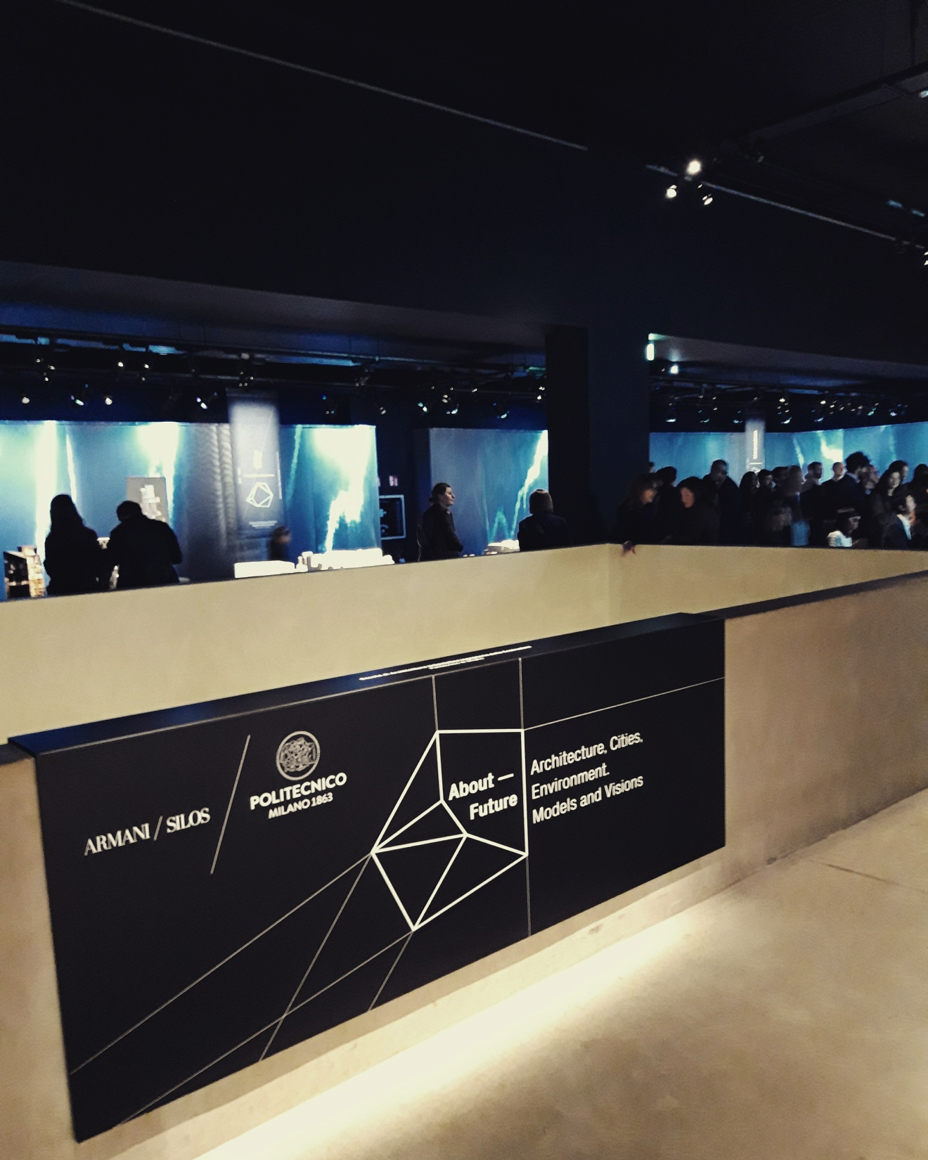
Exhibition at the
Armani Silos

Slide 47
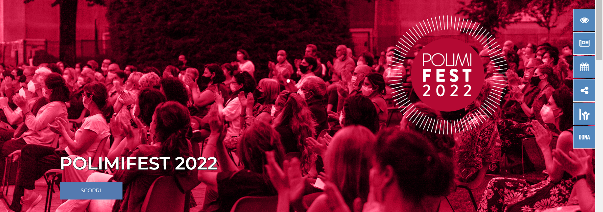
CULTURE
Free, and for all. With a dense network of relationships and strategic partnerships with national and international bodies and institutions, the University is a catalyst for culture. There are cycles of events, from science to technology, from architecture to design, from art to publishing.
Every year the Politecnico di Milano opens its doors to around 100,000 external visitors, who are attracted by a rich programme schedule that runs throughout the year. There are free initiatives, open to the city and able to transform the Politecnico into an increasingly lively and "shared" place.

Slide 48
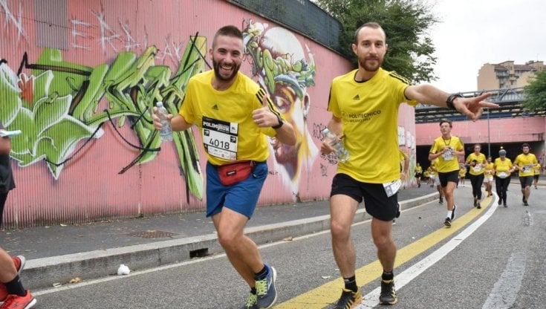
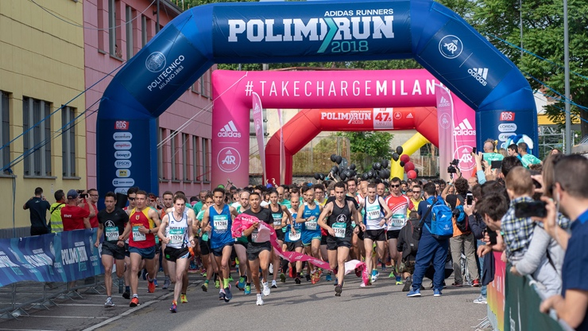
SPORT: POLIMIRUN

Slide 49
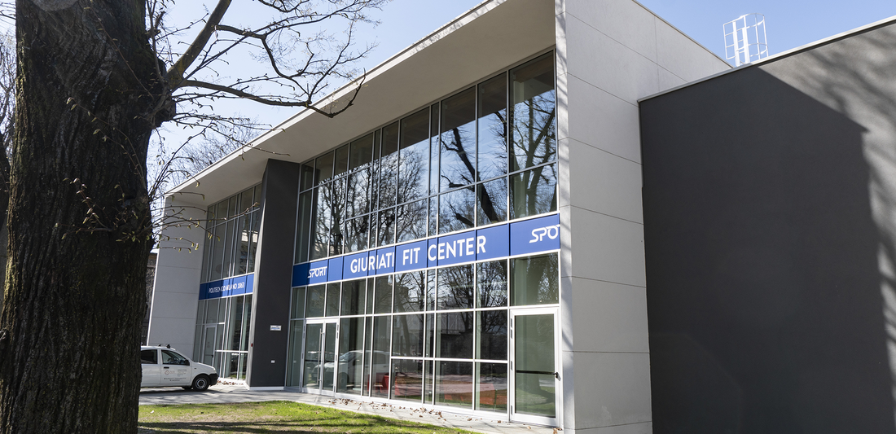
SPORT: GIURIATI FACILITIES

Slide 50
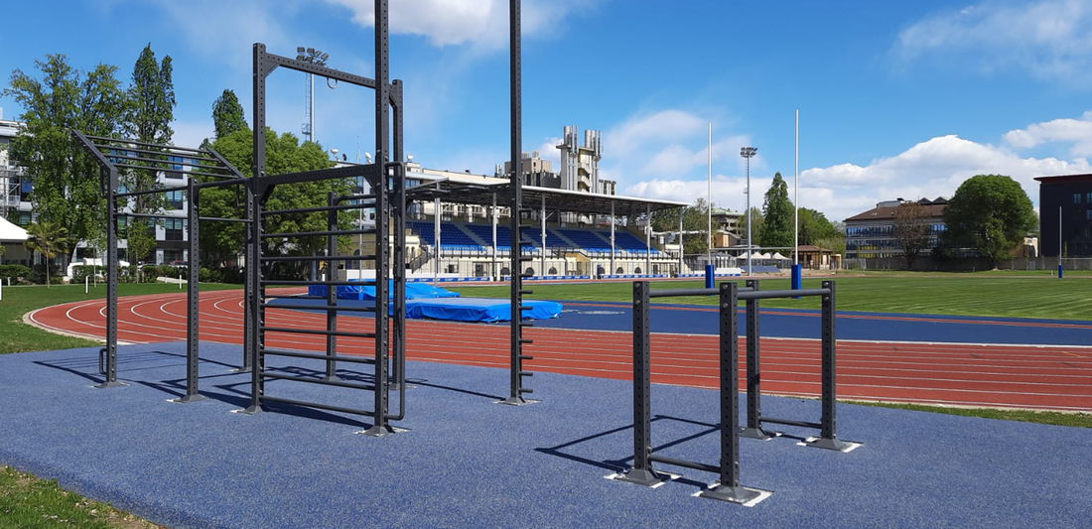
SPORT: GIURIATI FACILITIES

Slide 51
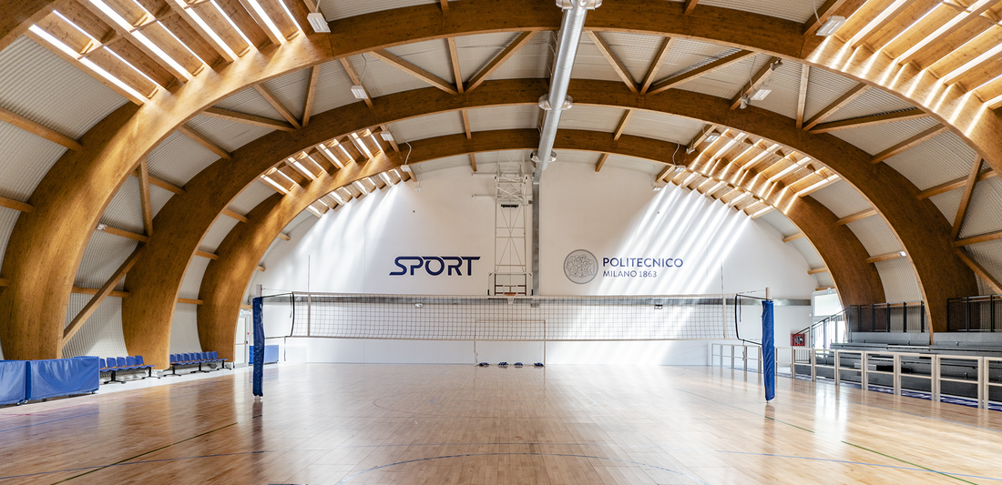
SPORT: GIURIATI FACILITIES

Slide 52
WWW.POLIMI.IT
WWW.AUIC.POLIMI.IT

